Slide 1
ECEN 150 Circuit Analysis I
First-Order Circuits

Slide 2
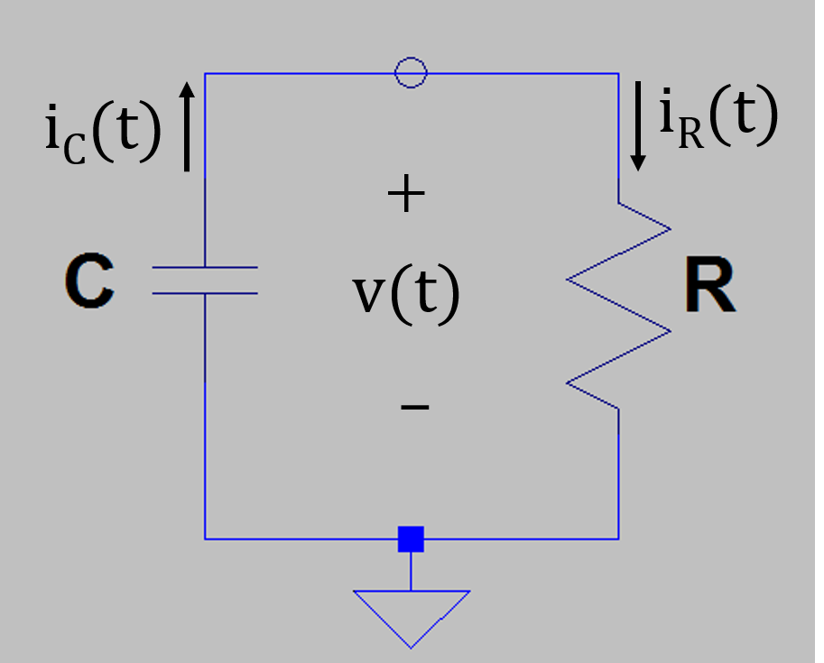
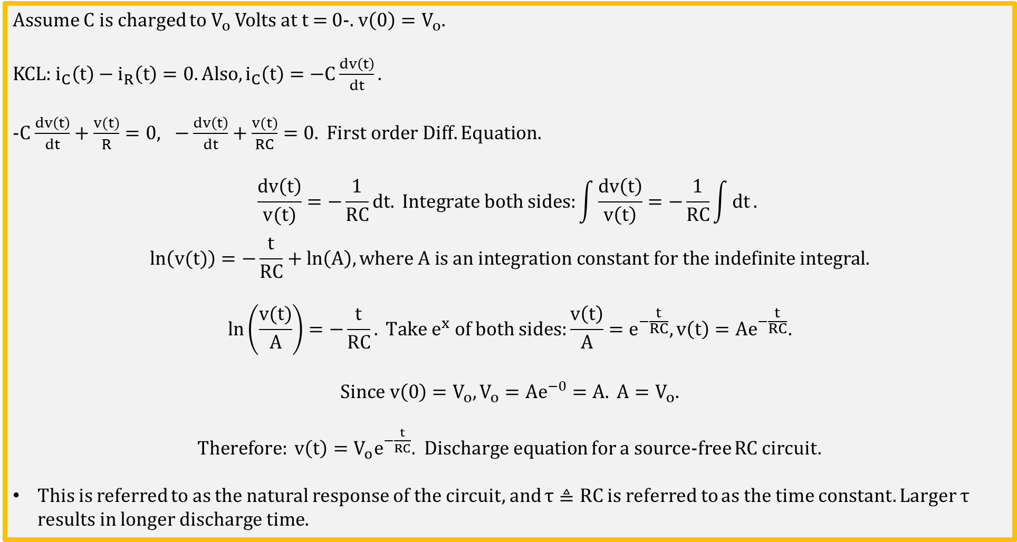
Source-Free RC Circuit
Assume C is charged to $V_{o}$ Volts at t = 0-. $v\left(0\right)=V_{o}.$
KCL: $i_{C}\left(t\right)−i_{R}\left(t\right)=0. Also, i_{C}\left(t\right)=−C\frac{dv\left(t\right)}{dt}.$
-$C$ $\frac{dv\left(t\right)}{dt}+\frac{v(t)}{R}=0, −\frac{dv\left(t\right)}{dt}+\frac{v(t)}{RC}=0. First order Diff. Equation.$
$$\frac{dv\left(t\right)}{v(t)}=−\frac{1}{RC}dt. Integrate both sides:\int{\frac{dv\left(t\right)}{v\left(t\right)}}=−\frac{1}{RC}\int{dt}.$$
$$ln\left(v(t)\right)=−\frac{t}{RC}+ln\left(A\right), where A is an integration constant for the indefinite integral.$$
$$ln\left(\frac{v(t)}{A}\right)=−\frac{t}{RC}. Take e^{x} of both sides:\frac{v\left(t\right)}{A}=e^{−\frac{t}{RC}},v\left(t\right)={Ae}^{−\frac{t}{RC}}.$$
$$Since v\left(0\right)=V_{o},V_{o}={Ae}^{−0}=A. A=V_{o}.$$
$Therefore: v\left(t\right)={V_{o}e}^{−\frac{t}{RC}}.$ Discharge equation for a source-free RC circuit.
This is referred to as the natural response of the circuit, and $τ≜RC$ is referred to as the time constant. Larger $τ$ results in longer discharge time.
Notes:
Image by instructor.

Slide 3
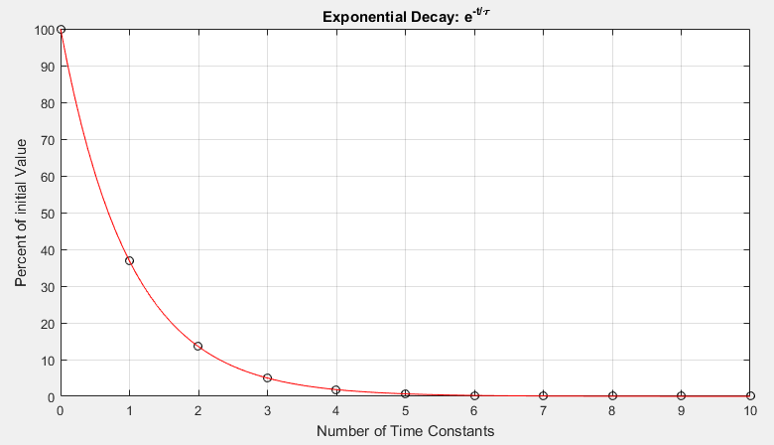
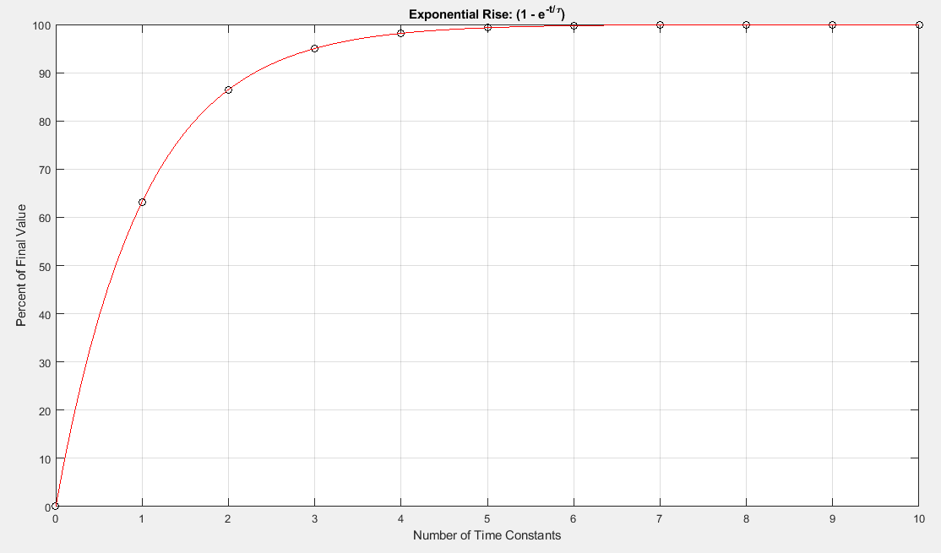
e^{-x} – Important Function in STEM
e^{-x} is bounded between 1 and 0.
Adjacent graph shows amplitude from 100% to 0%.
(1 - e^{-x} ) is bounded between 0 and 1.
Adjacent graph shows amplitude from 0% to 100%.

Slide 4
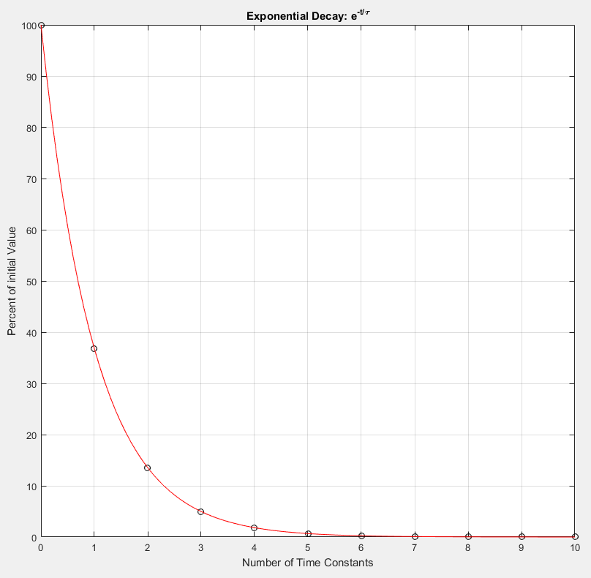
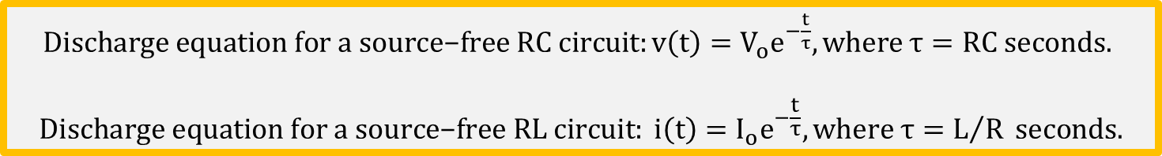
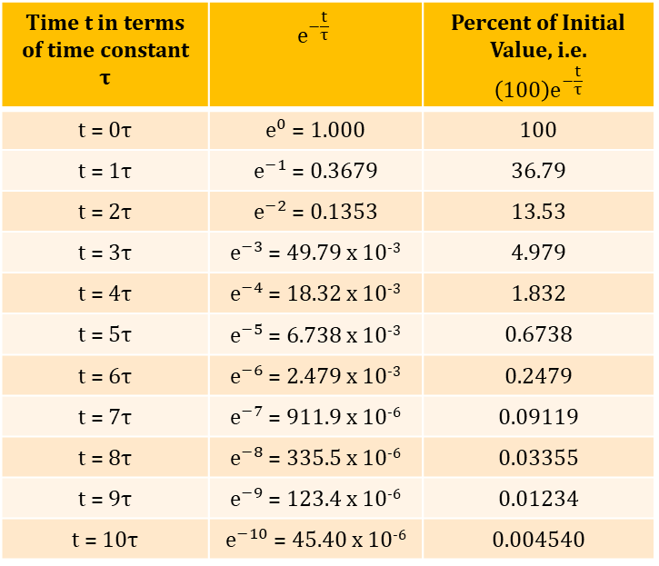
Exponential Decay and Time Constants
$\text{Discharge} \text{equation} \text{for} \text{a} \text{source}\text{−}\text{free} \text{RC} \text{circuit}:v\left(t\right)={V_{o}e}^{−\frac{t}{τ}}, where τ=RC seconds.$
$$\text{Discharge} \text{equation} \text{for} \text{a} \text{source}\text{−}\text{free} \text{RL} \text{circuit}: i\left(t\right)={I_{o}e}^{−\frac{t}{τ}},where τ=L/R seconds.$$
Exponential Decay
Time t in terms of time constant $τ$ | $$e^{−\frac{t}{τ}}$$ | Percent of Initial Value, i.e. $$\left(100\right)e^{−\frac{t}{τ}}$$
t = 0$τ$ | $e^{0}$ = 1.000 | 100
t = 1$τ$ | $e^{−1}$ = 0.3679 | 36.79
t = 2$τ$ | $e^{−2}$ = 0.1353 | 13.53
t = 3$τ$ | $e^{−3}$ = 49.79 x 10⁻³ | 4.979
t = 4$τ$ | $e^{−4}$ = 18.32 x 10⁻³ | 1.832
t = 5$τ$ | $e^{−5}$ = 6.738 x 10⁻³ | 0.6738
t = 6$τ$ | $e^{−6}$ = 2.479 x 10⁻³ | 0.2479
t = 7$τ$ | $e^{−7}$ = 911.9 x 10⁻⁶ | 0.09119
t = 8$τ$ | $e^{−8}$ = 335.5 x 10⁻⁶ | 0.03355
t = 9$τ$ | $e^{−9}$ = 123.4 x 10⁻⁶ | 0.01234
t = 10$τ$ | $e^{−10}$ = 45.40 x 10⁻⁶ | 0.004540

Slide 5
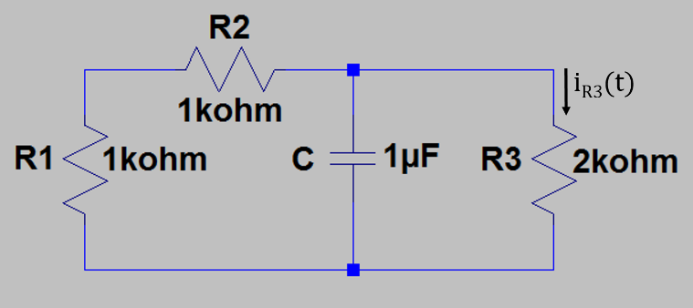
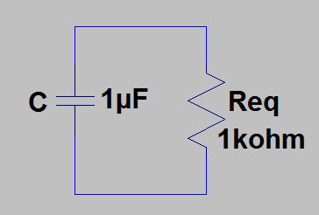
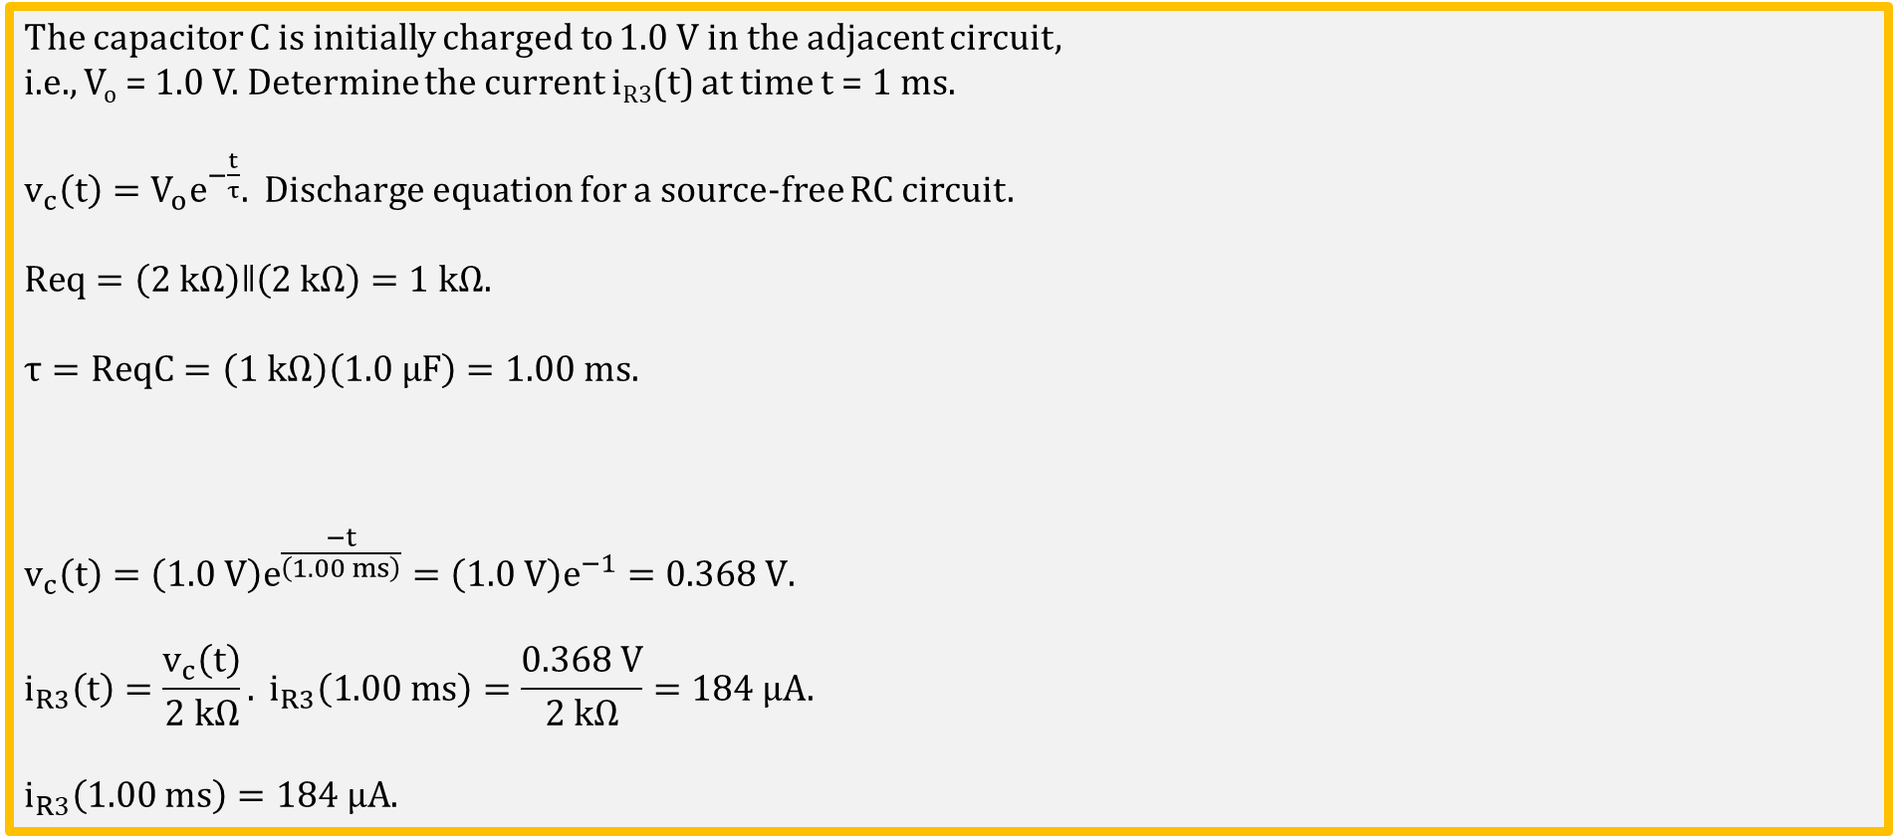
Source Free RC Circuit Example 1
The capacitor C is initially charged to 1.0 V in the adjacent circuit,
i.e., V_{o} = 1.0 V. Determine the current i_{R3}(t) at time t = 1 ms.
$v_{c}\left(t\right)={V_{o}e}^{−\frac{t}{τ}}.$ Discharge equation for a source-free RC circuit.
$$Req=\left(2 kΩ\right)ǁ\left(2 kΩ\right)=1 kΩ.$$
$$τ=ReqC=\left(\text{1} \text{k}\text{Ω}\right)\left(\text{1}\text{.}\text{0}\text{ µ}\text{F}\right)=1.00 ms.$$
$$v_{c}\left(t\right)={\left(1.0 V\right)e}^{\frac{−t}{\left(1.00 ms\right)}}={\left(1.0 V\right)e}^{−1}=0.368 V.$$
$$i_{R3}\left(t\right)=\frac{v_{c}\left(t\right)}{2 kΩ}. i_{R3}\left(1.00 ms\right)=\frac{0.368 V}{2 kΩ}=184 µA.$$
$$i_{R3}\left(1.00 ms\right)=184 µA.$$
Notes:
Image by instructor.

Slide 6
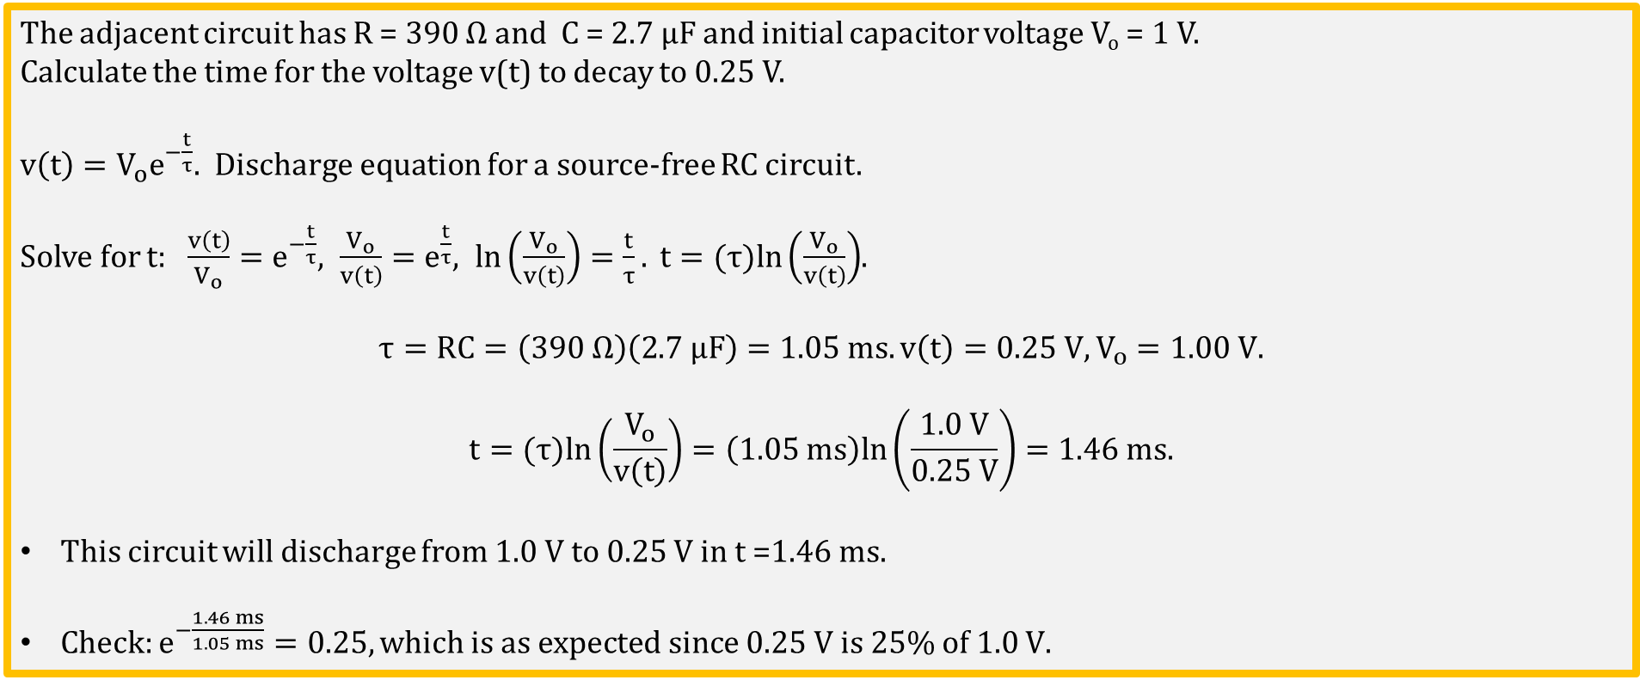
Source Free RC Circuit Example 2
The adjacent circuit has R = 390 Ω and C = 2.7 µF and initial capacitor voltage V_{o} = 1 V.
Calculate the time for the voltage v(t) to decay to 0.25 V.
$v\left(t\right)={V_{o}e}^{−\frac{t}{τ}}.$ Discharge equation for a source-free RC circuit.
Solve for $t:$ $\frac{v\left(t\right)}{V_{o}}=e^{−\frac{t}{τ}}, \frac{V_{o}}{v\left(t\right)}=e^{\frac{t}{τ}}, ln\left(\frac{V_{o}}{v\left(t\right)}\right)=\frac{t}{τ}. t=(τ)ln\left(\frac{V_{o}}{v\left(t\right)}\right)$.
$$τ=RC=\left(\text{39}\text{0 }\text{Ω}\right)\left(\text{2.7 µ}\text{F}\right)=1.05 ms. v\left(t\right)=0.25 V, V_{o}=1.00 V.$$
$$t=(τ)ln\left(\frac{V_{o}}{v\left(t\right)}\right)=\left(1.05 ms\right)ln\left(\frac{1.0 V}{0.25 V}\right)=1.46 ms.$$
This circuit will discharge from 1.0 V to 0.25 V in t =1.46 ms.
Check: $e^{−\frac{1.46 ms}{1.05 ms}}=0.25, which is as expected since \text{0.25 }\text{V} \text{is}\text{ 25\% }\text{of}\text{ 1.0 }\text{V}\text{.}$
Poll Questions
Notes:
Image by instructor.

Slide 7
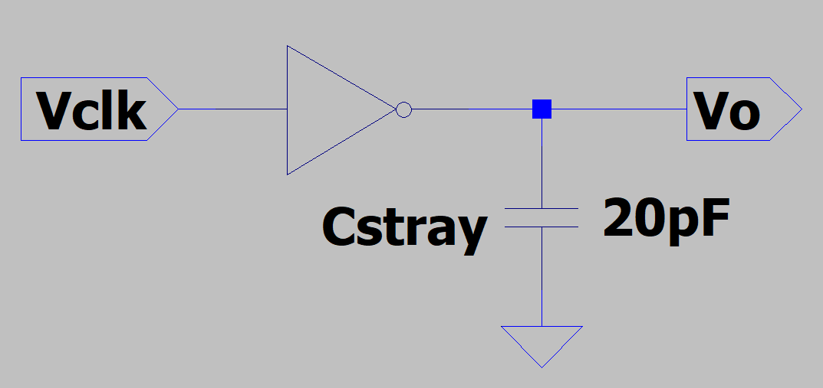
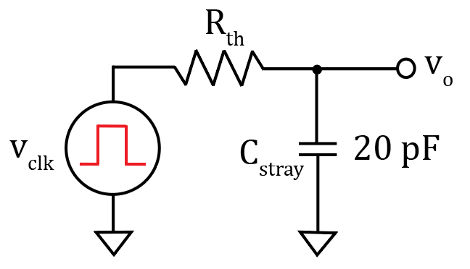
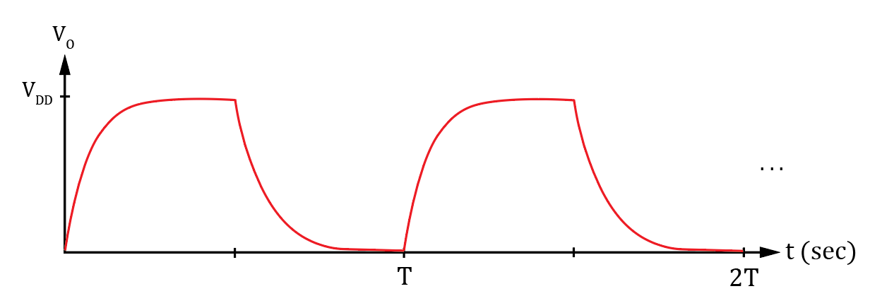
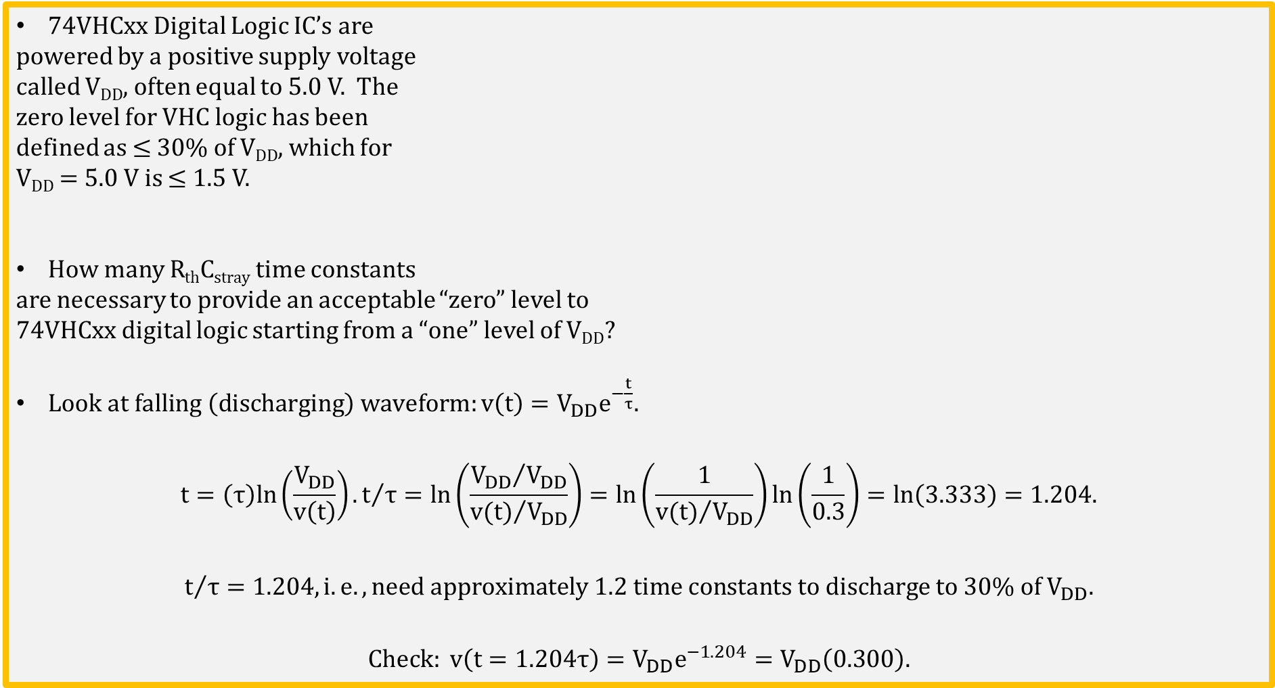
74VHCxx Digital Logic IC Fall Time
74VHCxx Digital Logic IC’s are
powered by a positive supply voltage
called V_{DD}, often equal to 5.0 V. The
zero level for VHC logic has been
defined as ≤ 30% of V_{DD}, which for
V_{DD} = 5.0 V is ≤ 1.5 V.
How many R_{th}C_{stray} time constants
are necessary to provide an acceptable “zero” level to
74VHCxx digital logic starting from a “one” level of V_{DD}?
$Look at falling \left(discharging\right) waveform:v\left(t\right)=V_{DD}e^{−\frac{t}{τ}}.$
$$t=\left(τ\right)ln\left(\frac{V_{DD}}{v\left(t\right)}\right). t/τ=ln\left(\frac{{V_{DD}}/{V_{DD}}}{{v(t)}/{V_{DD}}}\right)=ln\left(\frac{1}{{v(t)}/{V_{DD}}}\right)ln\left(\frac{1}{0.3}\right)=ln\left(3.333\right)=1.204.$$
$$t/τ=1.204, i.e. ,need approximately 1.2 time constants to discharge to 30\% of V_{DD}.$$
$Check: v\left(t=1.204τ\right)=V_{DD}e^{−1.204}=V_{DD}\left(0.300\right).$
Notes:
Image by instructor.

Slide 8
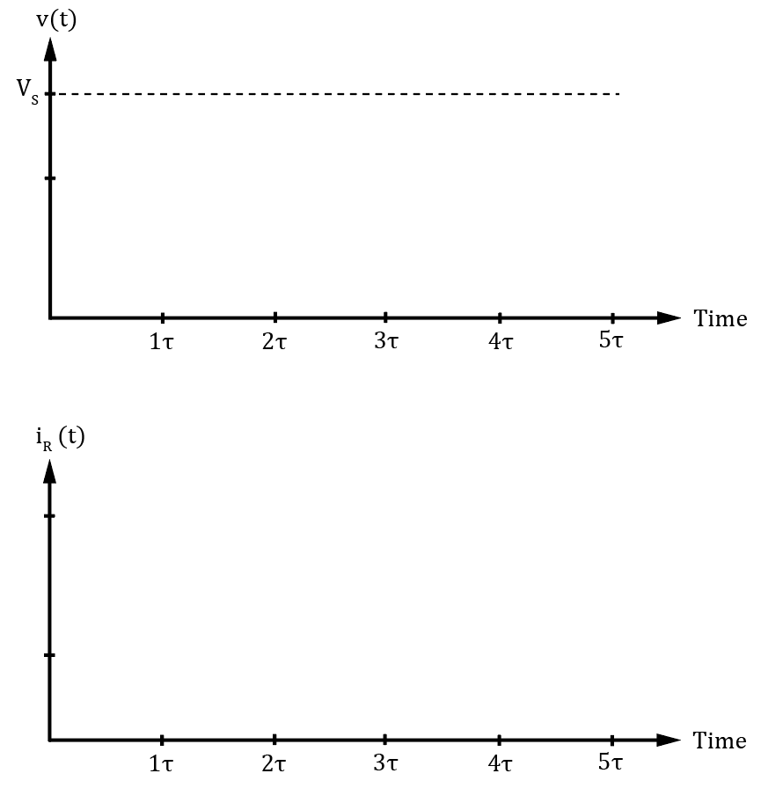
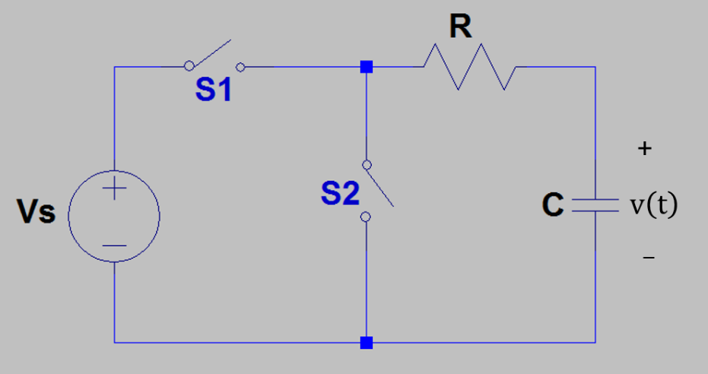
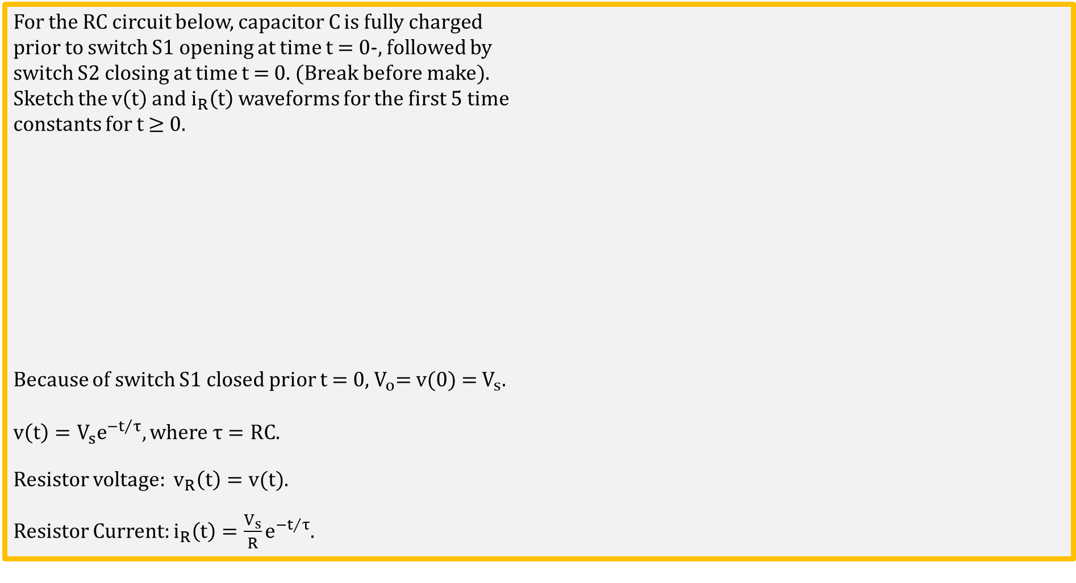
RC Discharging Waveforms
For the RC circuit below, capacitor C is fully charged
prior to switch S1 opening at time t = 0-, followed by
switch S2 closing at time t = 0. (Break before make).
Sketch the $v\left(t\right)$and $i_{R}\left(t\right)$ waveforms for the first 5 time
constants for t ≥ 0.
Because of switch S1 closed prior t = 0, $V_{o}\text{= }\text{v}\text{(0) = }V_{s}.$
$$v\left(t\right)=V_{s}e^{{−t}/τ}, where τ=RC.$$
Resistor voltage: $v_{R}\left(t\right)=v(t)$.
Resistor Current: $i_{R}\left(t\right)=\frac{V_{s}}{R}e^{{−t}/τ}$.
Capacitor voltage cannot change instantaneously, although capacitor current can change instantaneously.
Notes:
Images by instructor.

Slide 9
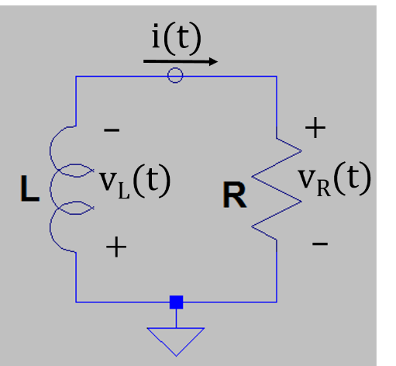
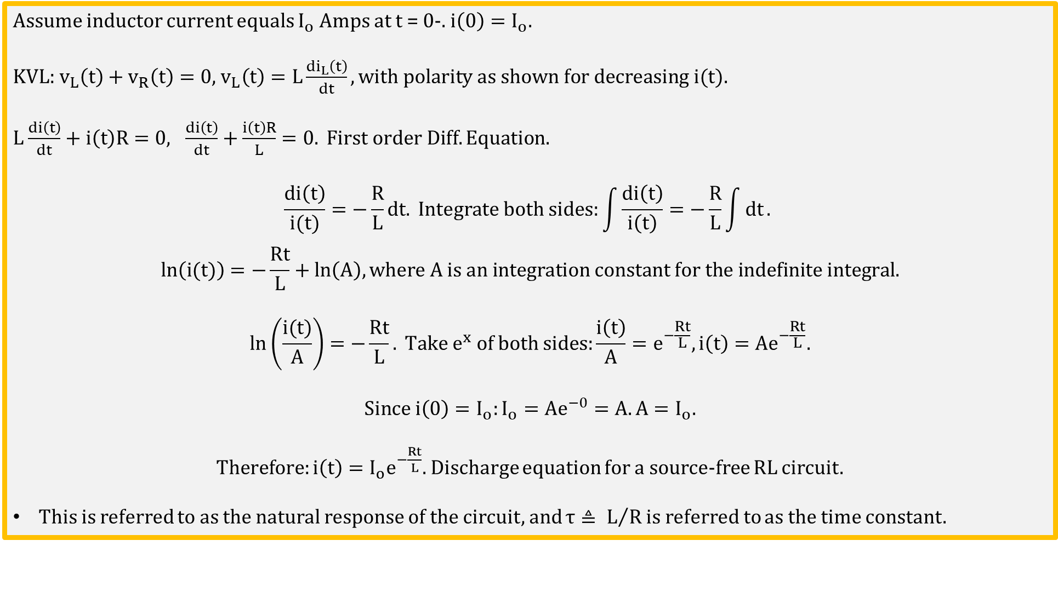
Source-Free RL Circuit
Assume inductor current equals $I_{o}$ Amps at t = 0-. $i\left(0\right)=I_{o}.$
KVL: $v_{L}\left(t\right)+v_{R}\left(t\right)=0$, $v_{L}\left(t\right)=L\frac{di_{L}\left(t\right)}{dt}, with polarity as shown for decreasing i(t).$
$L$ $\frac{di\left(t\right)}{dt}+i\left(t\right)R=0, \frac{di\left(t\right)}{dt}+\frac{i\left(t\right)R}{L}=0. First order Diff. Equation.$
$$\frac{di\left(t\right)}{i(t)}=−\frac{R}{L}dt. Integrate both sides:\int{\frac{di\left(t\right)}{i\left(t\right)}}=−\frac{R}{L}\int{dt}.$$
$$ln\left(i(t)\right)=−\frac{Rt}{L}+ln\left(A\right), where A is an integration constant for the indefinite integral.$$
$$ln\left(\frac{i(t)}{A}\right)=−\frac{Rt}{L}. Take e^{x} of both sides:\frac{i\left(t\right)}{A}=e^{−\frac{Rt}{L}},i\left(t\right)={Ae}^{−\frac{Rt}{L}}.$$
$$Since i\left(0\right)=I_{o}:I_{o}={Ae}^{−0}=A.A=I_{o}.$$
$Therefore:i\left(t\right)={I_{o}e}^{−\frac{Rt}{L}}.$ Discharge equation for a source-free RL circuit.
This is referred to as the natural response of the circuit, and $τ≜ L/R$ is referred to as the time constant.
Notes:
Image by instructor.

Slide 10
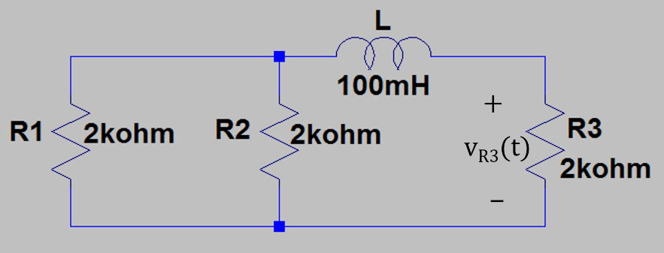
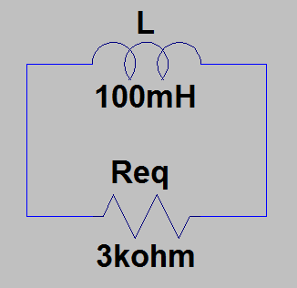
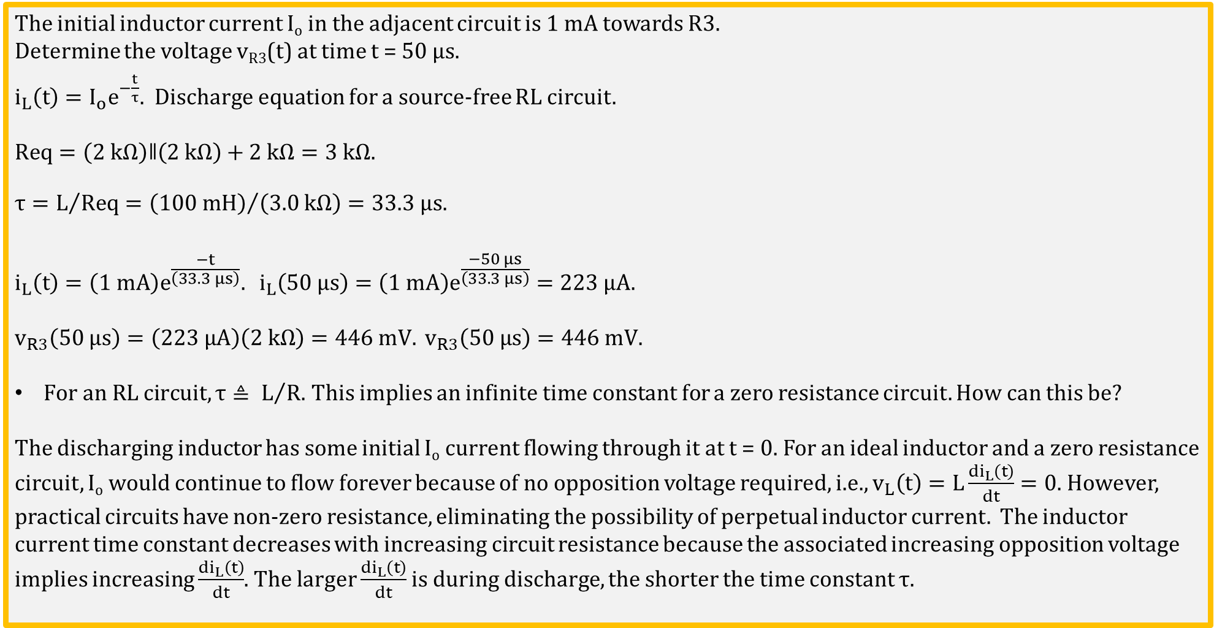
Source Free RL Circuit Example 1
The initial inductor current I_{o} in the adjacent circuit is 1 mA towards R3.
Determine the voltage v_{R3}(t) at time t = 50 µs.
$i_{L}\left(t\right)={I_{o}e}^{−\frac{t}{τ}}.$ Discharge equation for a source-free RL circuit.
$$Req=\left(2 kΩ\right)ǁ\left(2 kΩ\right)+2 kΩ=3 kΩ.$$
$$τ=L/{Req}={\left(\text{100 }\text{mH}\right)}/{\left(\text{3}\text{.0 }kΩ\right)}=33.3 μs.$$
$$i_{L}\left(t\right)={\left(1 mA\right)e}^{\frac{−t}{\left(33.3 μs\right)}}. i_{L}\left(\text{50 µ}\text{s}\right)={\left(1 mA\right)e}^{\frac{−50 μs}{\left(33.3 μs\right)}}=223 µA.$$
$$v_{R3}\left(\text{50 µ}\text{s}\right)=\left(223 µA\right)\left(2 kΩ\right)=446 mV. v_{R3}\left(\text{50 µ}\text{s}\right)=446 mV.$$
$For an RL circuit, τ≜ L/{R.}$ This implies an infinite time constant for a zero resistance circuit. How can this be?
The discharging inductor has some initial I_{o} current flowing through it at t = 0. For an ideal inductor and a zero resistance circuit, I_{o} would continue to flow forever because of no opposition voltage required, i.e., $v_{L}\left(t\right)=L\frac{{di}_{L}\left(t\right)}{dt}=0$. However, practical circuits have non-zero resistance, eliminating the possibility of perpetual inductor current. The inductor current time constant decreases with increasing circuit resistance because the associated increasing opposition voltage implies increasing $\frac{{di}_{L}\left(t\right)}{dt}$. The larger $\frac{{di}_{L}\left(t\right)}{dt}$ is during discharge, the shorter the time constant $τ$.
Notes:
Image by instructor.

Slide 11
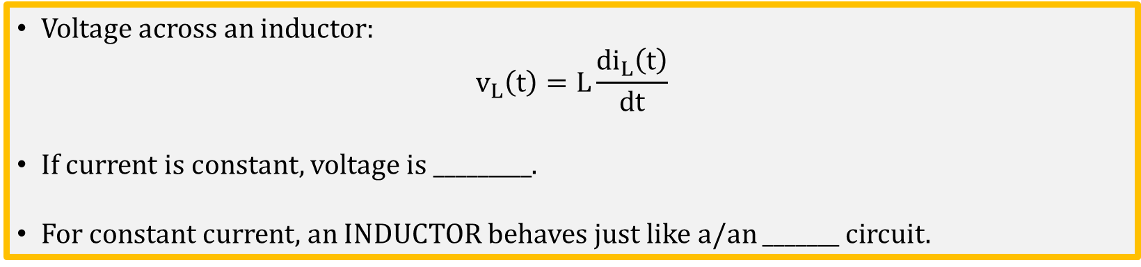
Inductors – Oppose Changes in Current.
Voltage across an inductor:
$$v_{L}\left(t\right)=L\frac{{di}_{L}\left(t\right)}{dt}$$
If current is constant, voltage is _________.
For constant current, an INDUCTOR behaves just like a/an _______ circuit.

Slide 12
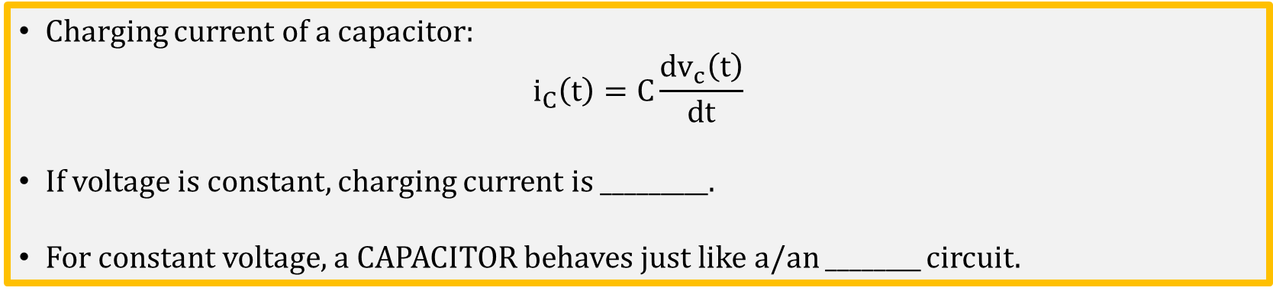
Capacitors – Oppose Changes in Voltage.
Charging current of a capacitor:
$$i_{C}\left(t\right)=C\frac{{dv}_{c}\left(t\right)}{dt}$$
If voltage is constant, charging current is _________.
For constant voltage, a CAPACITOR behaves just like a/an ________ circuit.

Slide 13
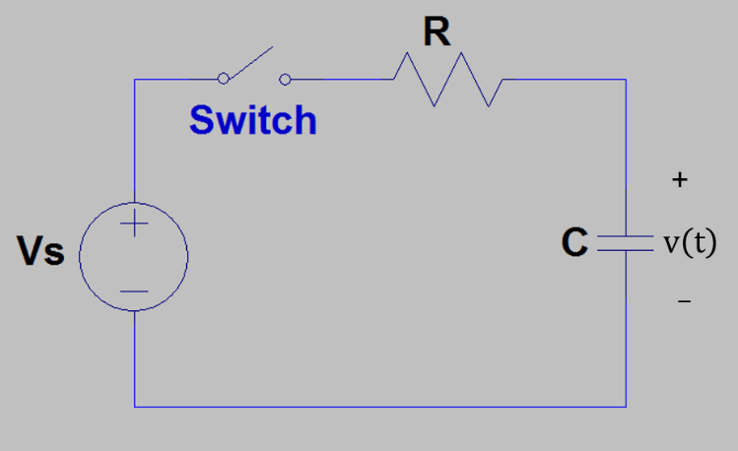
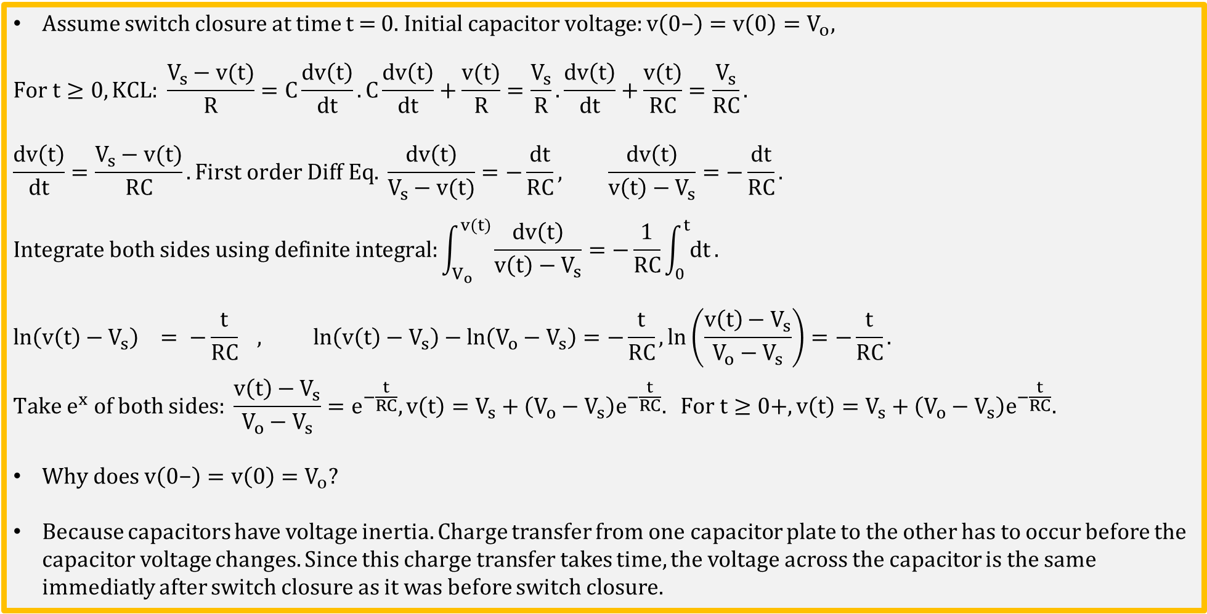
Step Response of a Series RC Circuit
Assume switch closure at time t = 0. $Initial capacitor voltage:v\left(0\text{−}\right)=v\left(0\right)=V_{o},$
$$For t≥0, KCL: \frac{V_{s}−v(t)}{R}=C\frac{dv\left(t\right)}{dt}.C\frac{dv\left(t\right)}{dt}+\frac{v(t)}{R}=\frac{V_{s}}{R}. \frac{dv\left(t\right)}{dt}+\frac{v(t)}{RC}=\frac{V_{s}}{RC}.$$
$$\frac{dv\left(t\right)}{dt}=\frac{V_{s}−v(t)}{RC}.First order Diff Eq. \frac{dv\left(t\right)}{V_{s}−v(t)}=−\frac{dt}{RC}, \frac{dv\left(t\right)}{v\left(t\right)−V_{s}}=−\frac{dt}{RC}.$$
$$Integrate both sides using definite integral:\int_{V_{o}}^{v(t)}{\frac{dv\left(t\right)}{v\left(t\right)−V_{s}}}=−\frac{1}{RC}\int_{0}^{t}{dt}.$$
$$ln\left(v\left(t\right)−V_{s}\right) = −\frac{t}{RC} , ln\left(v\left(t\right)−V_{s}\right)−ln\left(V_{o}−V_{s}\right)=−\frac{t}{RC}, ln\left(\frac{v\left(t\right)−V_{s}}{V_{o}−V_{s}}\right)=−\frac{t}{RC}.$$
$$Take e^{x} of both sides: \frac{v\left(t\right)−V_{s}}{V_{o}−V_{s}}=e^{−\frac{t}{RC}},v\left(t\right)=V_{s}+\left(V_{o}−V_{s}\right)e^{−\frac{t}{RC}}. For t≥0+,v\left(t\right)=V_{s}+\left(V_{o}−V_{s}\right)e^{−\frac{t}{RC}}.$$
$Why does v\left(0\text{−}\right)=v\left(0\right)=V_{o}?$
Because capacitors have voltage inertia. Charge transfer from one capacitor plate to the other has to occur before the capacitor voltage changes. Since this charge transfer takes time, the voltage across the capacitor is the same immediatly after switch closure as it was before switch closure.
v(t)
t
V_{o}
0
Notes:
Image by instructor.

Slide 14
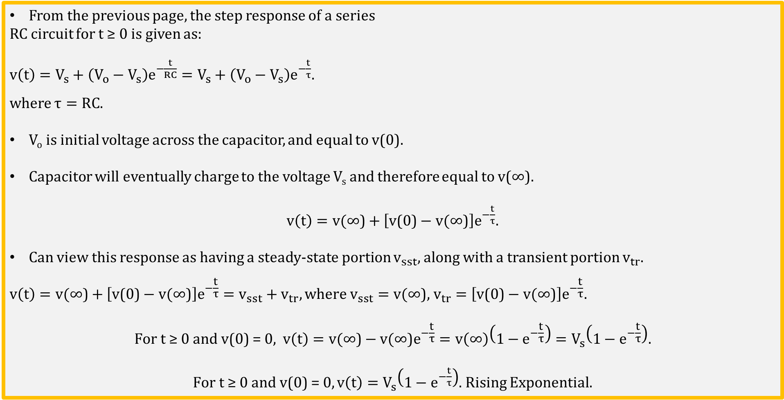
Step Response of a Series RC Circuit (Continued)
From the previous page, the step response of a series
RC circuit for t ≥ 0 is given as:
$v\left(t\right)=V_{s}+\left(V_{o}−V_{s}\right)e^{−\frac{t}{RC}}=V_{s}+\left(V_{o}−V_{s}\right)e^{−\frac{t}{τ}}.$
where $τ=RC.$
V_{o} is initial voltage across the capacitor, and equal to v(0).
Capacitor will eventually charge to the voltage V_{s} and therefore equal to v(∞).
$v\left(t\right)=v(\text{∞}\text{)}+\left[\text{v}\text{(0)}−v(\text{∞)}\right]e^{−\frac{t}{τ}}.$
Can view this response as having a steady-state portion $v_{sst},$ along with a transient portion $v_{tr}$.
$$v\left(t\right)=v(\text{∞)}+\left[\text{v}\text{(0)}−v(\text{∞)}\right]e^{−\frac{t}{τ}}=v_{sst}+v_{tr}, where v_{sst}=v(\text{∞)}\text{,}{ v}_{tr}=\left[\text{v}\text{(0)}−v(\text{∞)}\right]e^{−\frac{t}{τ}}.$$
$$\text{F}\text{or} \text{t}\text{ ≥ 0 }\text{and} \text{v}\text{(0) = 0, }v\left(t\right)=v(\text{∞)}−v(\text{∞)}e^{−\frac{t}{τ}}=v\left(\text{∞}\right)\left(1−e^{−\frac{t}{τ}}\right)=V_{s}\left(1−e^{−\frac{t}{τ}}\right).$$
$\text{F}\text{or} \text{t}\text{ ≥ 0 }\text{and} \text{v}\text{(0) = 0},v\left(t\right)=V_{s}\left(1−e^{−\frac{t}{τ}}\right)$. Rising Exponential.
Notes:
Image by instructor.

Slide 15
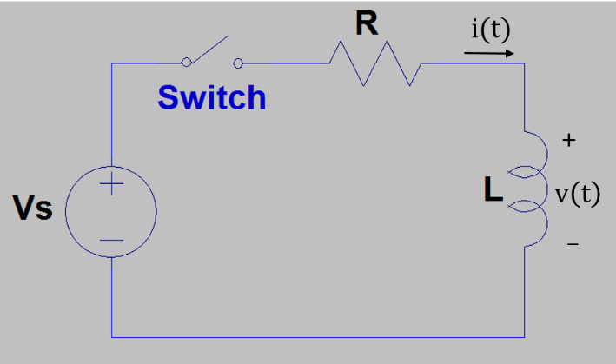
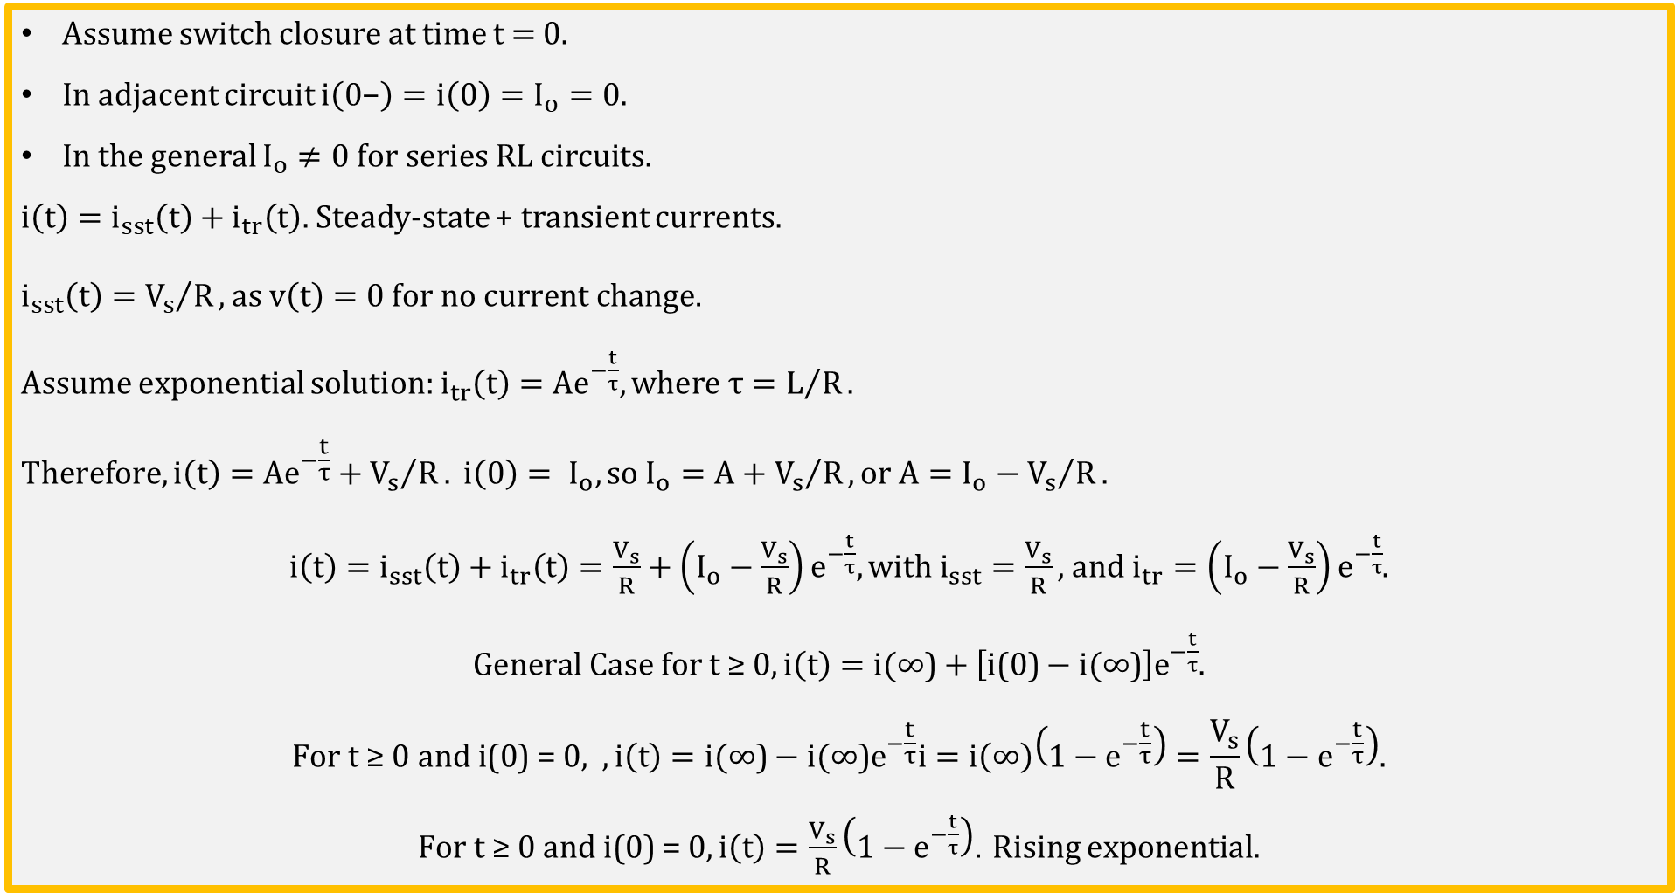
Step Response of a Series RL Circuit
Assume switch closure at time t = 0.
In adjacent circuit $i\left(0\text{−}\right)=i\left(0\right)=I_{o}=0.$
In the general $I_{o}≠0 for series RL circuits.$
$i\left(t\right)=i_{sst}\left(t\right)+i_{tr}\left(t\right).$ Steady-state + transient currents.
$i_{sst}\left(t\right)={V_{s}}/R, as v\left(t\right)=0 for no current change$.
Assume exponential solution: $i_{tr}\left(t\right)=Ae^{−\frac{t}{τ}}, where τ=L/R.$
$$Therefore, i\left(t\right)=Ae^{−\frac{t}{τ}}+{V_{s}}/R. i\left(0\right)= I_{o}, so I_{o}=A+{V_{s}}/R, or A=I_{o}−{V_{s}}/R.$$
$i\left(t\right)=i_{sst}\left(t\right)+i_{tr}\left(t\right)=\frac{V_{s}}{R}+\left(I_{o}−\frac{V_{s}}{R}\right)e^{−\frac{t}{τ}}, with i_{sst}=\frac{V_{s}}{R},$ and $i_{tr}=\left(I_{o}−\frac{V_{s}}{R}\right)e^{−\frac{t}{τ}}$.
$General Case for t \text{≥} 0, i\left(t\right)=i(\text{∞)}+\left[\text{i}\text{(0)}−i(\text{∞)}\right]e^{−\frac{t}{τ}}$.
$$\text{F}\text{or} \text{t}\text{ ≥ 0 }\text{and} \text{i}\text{(0) = 0, }, i\left(t\right)=i(\text{∞)}−{i(\text{∞)}e}^{−\frac{t}{τ}}i=i\left(\text{∞}\right)\left(1−e^{−\frac{t}{τ}}\right)=\frac{V_{s}}{R}\left(1−e^{−\frac{t}{τ}}\right).$$
$\text{F}\text{or} \text{t}\text{ ≥ 0 }\text{and} \text{i}\text{(0) = 0},i\left(t\right)=\frac{V_{s}}{R}\left(1−e^{−\frac{t}{τ}}\right)$. Rising exponential.
Notes:
Image by instructor.

Slide 16
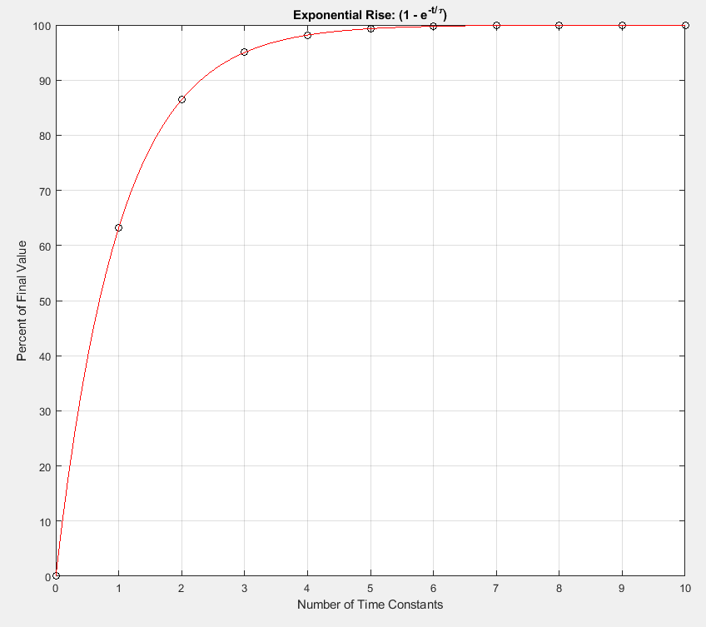
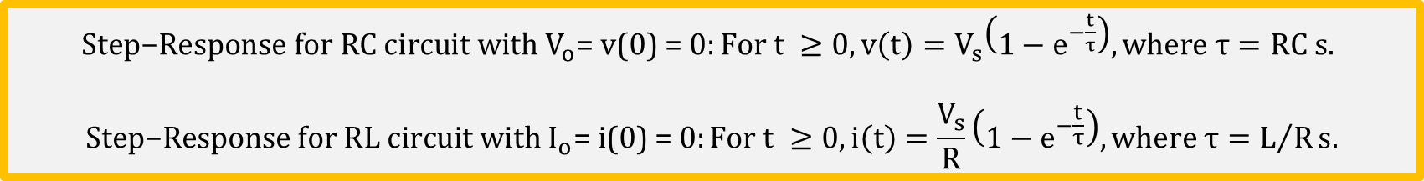
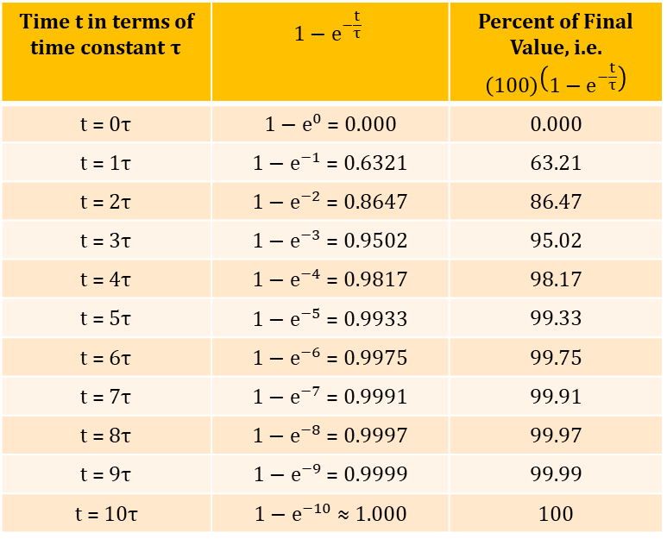
Exponential Rise and Time Constants
$\text{Step}\text{−}\text{Response} \text{for} \text{RC} \text{circuit} \text{wit}h V_{o}\text{= }\text{v}\text{(0) = 0}:\text{For} \text{t} ≥0,v\left(t\right)=V_{s}\left(1−e^{−\frac{t}{τ}}\right), where τ=RC s.$
$$\text{Step}\text{−}\text{Response} \text{for} \text{RL} \text{circuit} \text{with} I_{o}\text{= }\text{i}\text{(0) = 0}:\text{For} \text{t} ≥0, i\left(t\right)=\frac{V_{s}}{R}\left(1−e^{−\frac{t}{τ}}\right),where τ=L/Rs.$$
Exponential Rise
Time t in terms of time constant $τ$ | $$1−e^{−\frac{t}{τ}}$$ | Percent of Final Value, i.e. $$\left(100\right)\left(1−e^{−\frac{t}{τ}}\right)$$
t = 0$τ$ | $1−e^{0}$ = 0.000 | 0.000
t = 1$τ$ | $1−e^{−1}$ = 0.6321 | 63.21
t = 2$τ$ | $1−e^{−2}$ = 0.8647 | 86.47
t = 3$τ$ | ${1−e}^{−3}$ = 0.9502 | 95.02
t = 4$τ$ | ${1−e}^{−4}$ = 0.9817 | 98.17
t = 5$τ$ | ${1−e}^{−5}$ = 0.9933 | 99.33
t = 6$τ$ | ${1−e}^{−6}$ = 0.9975 | 99.75
t = 7$τ$ | ${1−e}^{−7}$ = 0.9991 | 99.91
t = 8$τ$ | ${1−e}^{−8}$ = 0.9997 | 99.97
t = 9$τ$ | ${1−e}^{−9}$ = 0.9999 | 99.99
t = 10$τ$ | $1−e^{−10}$ ≈ 1.000 | 100

Slide 17

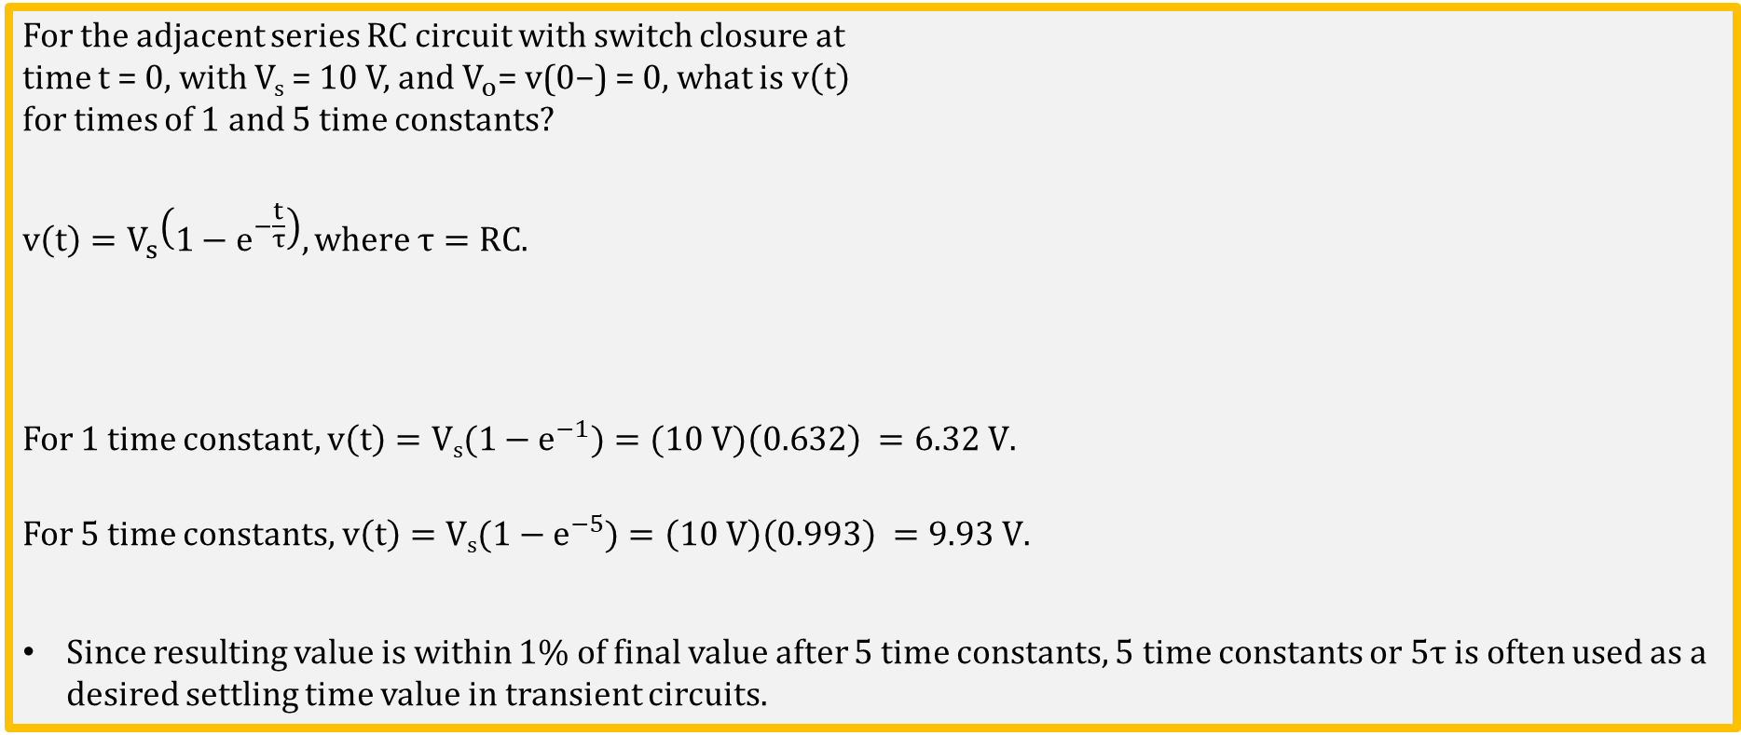
Capacitor Charging Example
For the adjacent series RC circuit with switch closure at
time t = 0, with V_{s} = 10 V, and $V_{o}\text{= }\text{v}\text{(0}\text{−}\text{) = 0},$what is $v\left(t\right)$
for times of 1 and 5 time constants?
$$v\left(t\right)=V_{s}\left(1−e^{−\frac{t}{τ}}\right), where τ=RC.$$
For 1 time constant, $v\left(t\right)=\text{V}\text{s}{(1−e}^{−1})=(10 V)\left(0.632\right) =6.32 V.$
For 5 time constants, $v\left(t\right)=\text{V}\text{s}{(1−e}^{−5})=\left(10 V\right)\left(0.993\right) =9.93 V.$
Since resulting value is within 1% of final value after 5 time constants, 5 time constants or 5τ is often used as a desired settling time value in transient circuits.
Notes:
Image by instructor.

Slide 18

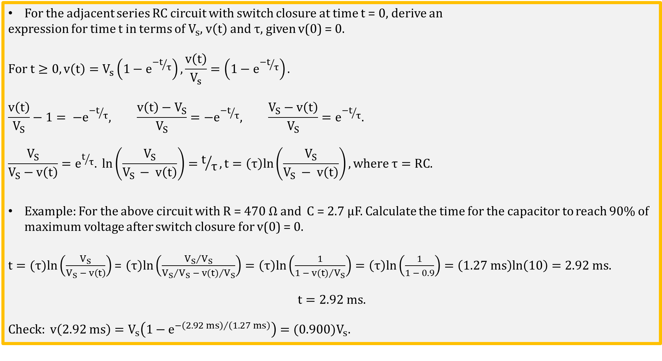
Capacitor Charging Time
For the adjacent series RC circuit with switch closure at time t = 0, derive an
expression for time t in terms of $V_{s}$, $v\left(t\right)$ and τ, given v(0) = 0.
$$For t≥0, v\left(t\right)=V_{s}\left(1−e^{{−t}/τ}\right), \frac{v\left(t\right)}{V_{s}}=\left(1−e^{{−t}/τ}\right).$$
$$\frac{v\left(t\right)}{V_{S}}−1= {−e}^{{−t}/τ}, \frac{v\left(t\right)−V_{S}}{V_{S}}={−e}^{{−t}/τ}, \frac{V_{S}−v\left(t\right)}{V_{S}}=e^{{−t}/τ}.$$
$$\frac{V_{S}}{V_{S}−v\left(t\right)}=e^{t/τ}. ln\left(\frac{V_{S}}{V_{S }− v\left(t\right)}\right)=t/τ, t=\left(τ\right)ln\left(\frac{V_{S}}{V_{S} − v\left(t\right)}\right), where τ=RC.$$
Example: For the above circuit with R = 470 Ω and C = 2.7 µF. Calculate the time for the capacitor to reach 90% of maximum voltage after switch closure for v(0) = 0.
$t=(τ)ln\left(\frac{V_{S}}{V_{S} − v\left(t\right)}\right)$ = $\left(τ\right)ln\left(\frac{{V_{S}}/{V_{S}}}{{V_{S}}/{V_{S}} − {v(t)}/{V_{S}}}\right)=\left(τ\right)ln\left(\frac{1}{1 − {v(t)}/{V_{S}}}\right)=\left(τ\right)ln\left(\frac{1}{1 − 0.9}\right)=\left(1.27 ms\right)ln\left(10\right)=2.92 ms.$
$$t=2.92 ms.$$
$$Check: v\left(2.92 ms\right)=V_{s}\left(1−e^{{−\left(2.92 ms\right)}/{\left(1.27 ms\right)}}\right)={(0.900)V}_{s}.$$
Notes:
Image by instructor.

Slide 19
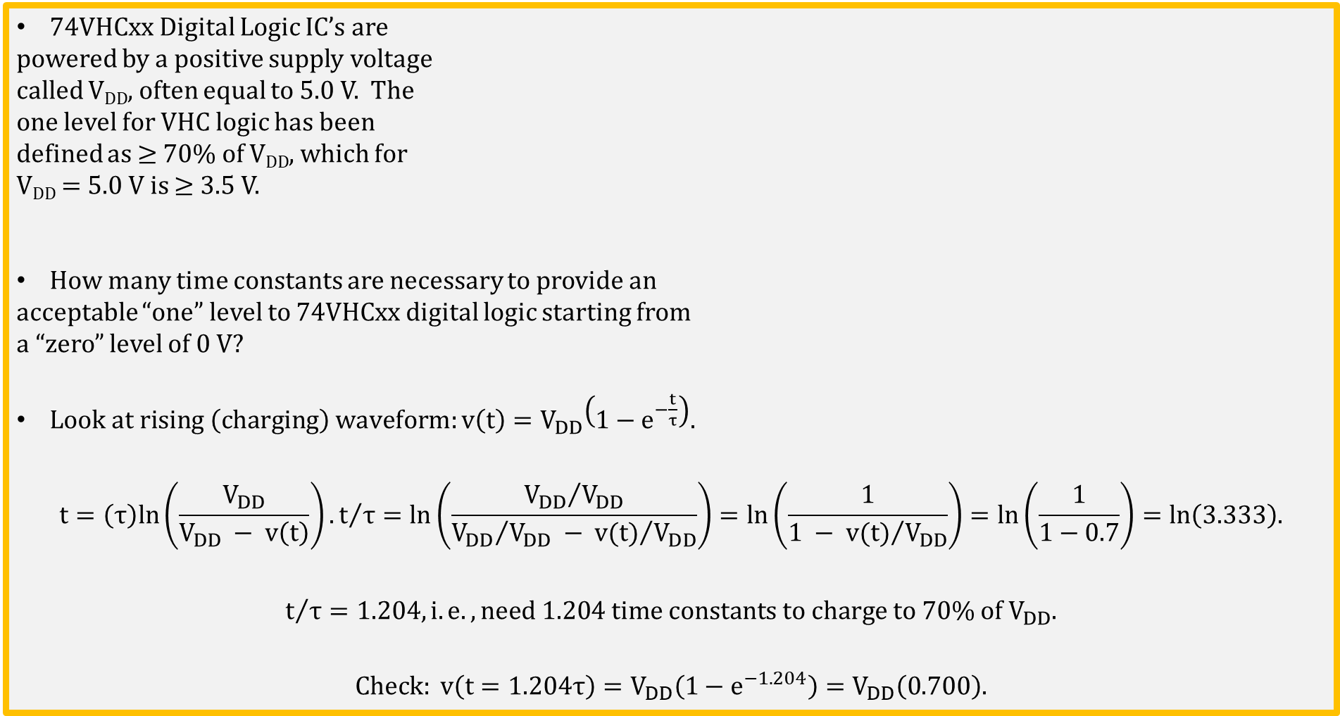
74VHCxx Digital Logic IC Rise Time
74VHCxx Digital Logic IC’s are
powered by a positive supply voltage
called V_{DD}, often equal to 5.0 V. The
one level for VHC logic has been
defined as ≥ 70% of V_{DD}, which for
V_{DD} = 5.0 V is ≥ 3.5 V.
How many time constants are necessary to provide an
acceptable “one” level to 74VHCxx digital logic starting from
a “zero” level of 0 V?
$Look at rising \left(charging\right) waveform:v\left(t\right)=V_{DD}\left(1−e^{−\frac{t}{τ}}\right).$
$$t=\left(τ\right)ln\left(\frac{V_{DD}}{V_{DD} − v\left(t\right)}\right). t/τ=ln\left(\frac{{V_{DD}}/{V_{DD}}}{{V_{DD}}/{V_{DD}} − {v(t)}/{V_{DD}}}\right)=ln\left(\frac{1}{1 − {v(t)}/{V_{DD}}}\right)=ln\left(\frac{1}{1−0.7}\right)=ln\left(3.333\right).$$
$$t/τ=1.204, i.e. ,need 1.204 time constants to charge to 70\% of V_{DD}.$$
$Check: v\left(t=1.204τ\right)=V_{DD}\left(1−e^{−1.204}\right)=V_{DD}\left(0.700\right).$
Notes:
Image by instructor.

Slide 20
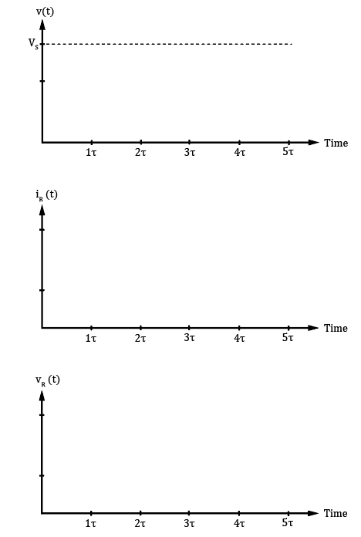
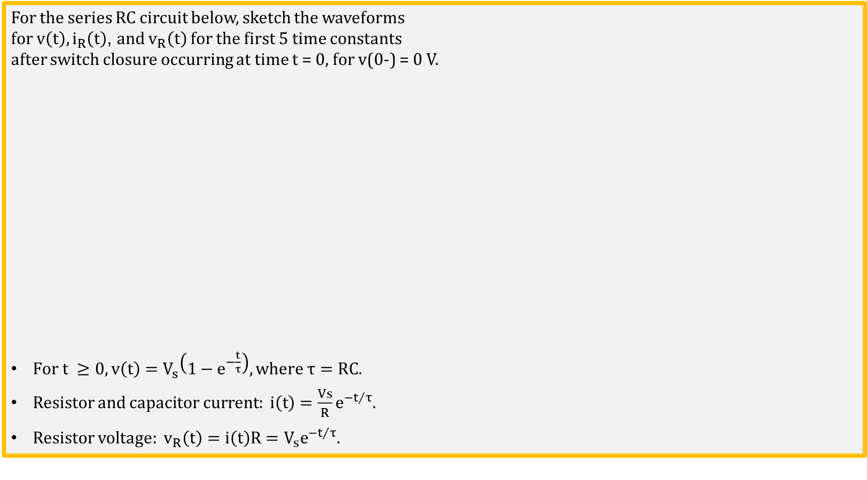
RC Charging Waveforms
For the series RC circuit below, sketch the waveforms
for $v\left(t\right), i_{R}\left(t\right)$, and $v_{R}\left(t\right)$ for the first 5 time constants
after switch closure occurring at time t = 0, for v(0-) = 0 V.
$\text{For} \text{t} ≥0,v\left(t\right)=V_{s}\left(1−e^{−\frac{t}{τ}}\right), where τ=RC.$
Resistor and capacitor current: $i\left(t\right)=\frac{Vs}{R}e^{{−t}/τ}$.
Resistor voltage: $v_{R}\left(t\right)={i\left(t\right)R=V}_{s}e^{{−t}/τ}$.
Notes:
Images by instructor.

Slide 21

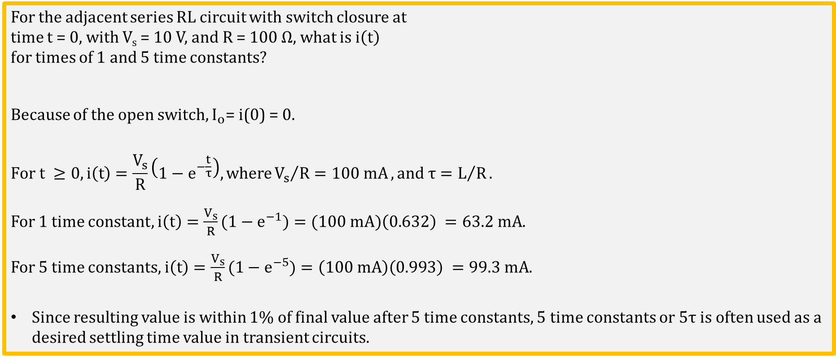
Inductor Current Ramp-Up Example
For the adjacent series RL circuit with switch closure at
time t = 0, with V_{s} = 10 V, and R = 100 Ω$,$what is $i\left(t\right)$
for times of 1 and 5 time constants?
Because of the open switch, $I_{o}\text{= }\text{i}\text{(0) = 0}.$
$$\text{For} \text{t} ≥0, i\left(t\right)=\frac{V_{s}}{R}\left(1−e^{−\frac{t}{τ}}\right),where{V_{s}}/{R=100 mA}, and τ=L/R.$$
For 1 time constant, $i\left(t\right)={\frac{V_{s}}{R}(1−e}^{−1})=(100 mA)\left(0.632\right) =63.2 mA.$
For 5 time constants, $i\left(t\right)={\frac{V_{s}}{R}(1−e}^{−5})=\left(100 mA\right)\left(0.993\right) =99.3 mA.$
Since resulting value is within 1% of final value after 5 time constants, 5 time constants or 5τ is often used as a desired settling time value in transient circuits.
Poll Questions
Notes:
Image by instructor.

Slide 22
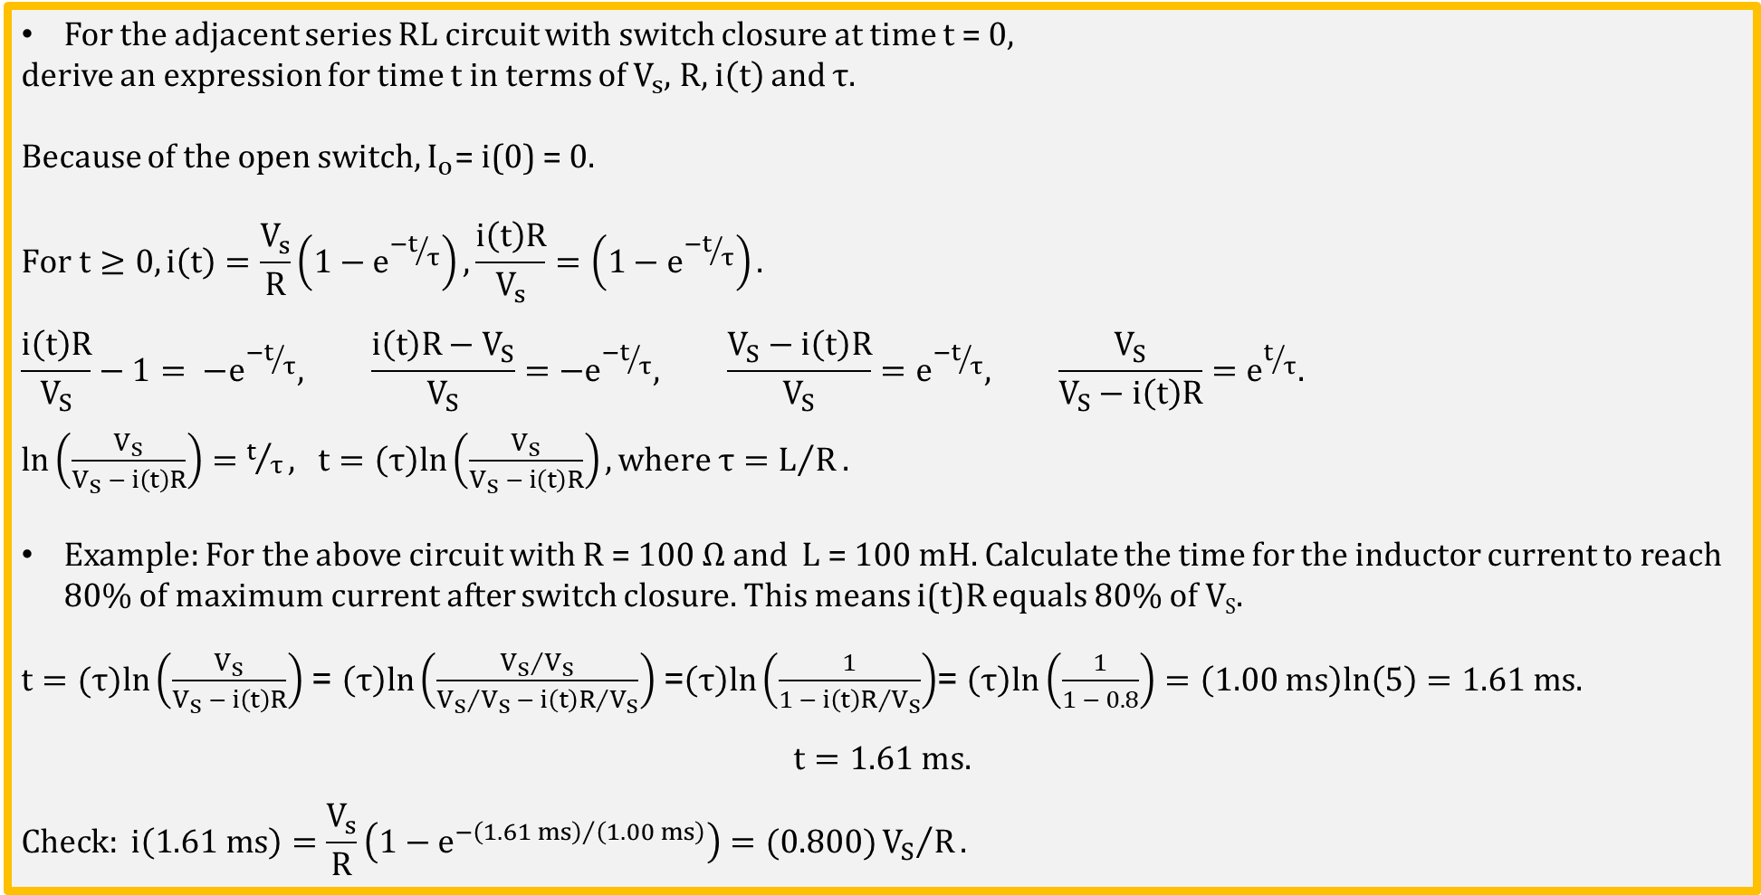
RL Circuit Ramp-Up Time
For the adjacent series RL circuit with switch closure at time t = 0,
derive an expression for time t in terms of $V_{s}$, R, $i\left(t\right)$ and τ.
Because of the open switch, $I_{o}\text{= }\text{i}\text{(0) = 0}.$
$$For t≥0, i\left(t\right)=\frac{V_{s}}{R}\left(1−e^{{−t}/τ}\right), \frac{i\left(t\right)R}{V_{s}}=\left(1−e^{{−t}/τ}\right).$$
$$\frac{i\left(t\right)R}{V_{S}}−1= {−e}^{{−t}/τ}, \frac{i\left(t\right)R−V_{S}}{V_{S}}={−e}^{{−t}/τ}, \frac{V_{S}−i\left(t\right)R}{V_{S}}=e^{{−t}/τ}, \frac{V_{S}}{V_{S}−i\left(t\right)R}=e^{t/τ}.$$
$ln\left(\frac{V_{S}}{V_{S} − i\left(t\right)R}\right)=t/τ,$ $t=\left(τ\right)ln\left(\frac{V_{S}}{V_{S} − i\left(t\right)R}\right), where τ=L/R.$
Example: For the above circuit with R = 100 Ω and L = 100 mH. Calculate the time for the inductor current to reach 80% of maximum current after switch closure. This means i(t)R equals 80% of V_{S}.
$t=(τ)ln\left(\frac{V_{S}}{V_{S} − i\left(t\right)R}\right)$ = $\left(τ\right)ln\left(\frac{{V_{S}}/{V_{S}}}{{V_{S}}/{V_{S}} − {i\left(t\right)R}/{V_{S}}}\right)$ =$\left(τ\right)ln\left(\frac{1}{1 − {i\left(t\right)R}/{V_{S}}}\right)$= $\left(τ\right)ln\left(\frac{1}{1 − 0.8}\right)=\left(1.00 ms\right)ln\left(5\right)=1.61 ms.$
$$t=1.61 ms.$$
$$Check: i\left(1.61 ms\right)=\frac{V_{s}}{R}\left(1−e^{{−\left(1.61 ms\right)}/{\left(1.00 ms\right)}}\right)=(0.800){V_{S}}/R.$$
Notes:
Image by instructor.

Slide 23
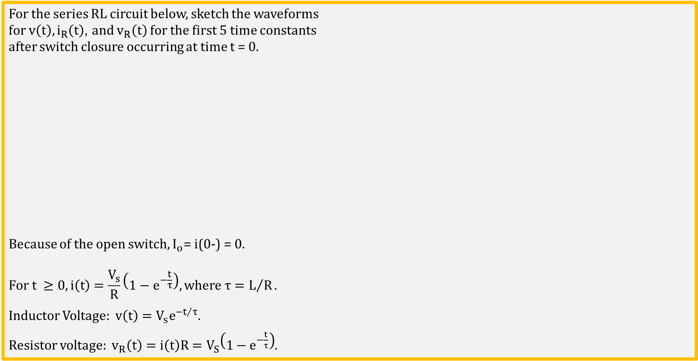



RL Current Ramp-Up Waveforms !!!!
For the series RL circuit below, sketch the waveforms
for $v\left(t\right), i_{R}\left(t\right)$, and $v_{R}\left(t\right)$ for the first 5 time constants
after switch closure occurring at time t = 0$.$
Because of the open switch, $I_{o}\text{= }\text{i}\text{(0}\text{−}\text{) = 0}.$
$$\text{For} \text{t} ≥0,i\left(t\right)=\frac{V_{s}}{R}\left(1−e^{−\frac{t}{τ}}\right), where τ=L/R.$$
Inductor Voltage: $v\left(t\right)={V_{s}e}^{{−t}/τ}$.
Resistor voltage: $v_{R}\left(t\right)={i\left(t\right)R=V}_{S}\left(1−e^{−\frac{t}{τ}}\right)$.
$$v\left(t\right)$$
t = 0
Time
5τ
$$i_{R}\left(t\right)$$
t = 0
Time
5τ
$$v_{R}\left(t\right)$$
t = 0
Time
5τ
Notes:
Images by instructor.

Slide 24
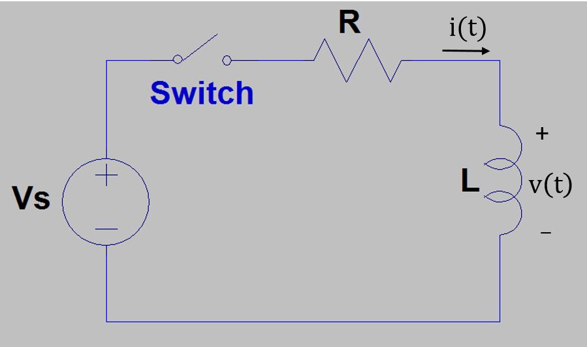
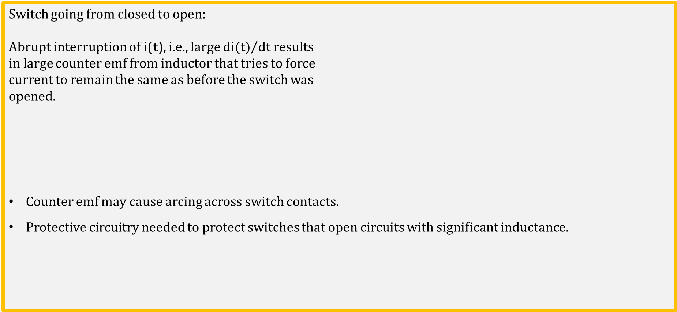
Open Circuiting an Inductive Circuit
Switch going from closed to open:
Abrupt interruption of i(t), i.e., large ${di(t)}/{dt}$ results
in large counter emf from inductor that tries to force
current to remain the same as before the switch was
opened.
Counter emf may cause arcing across switch contacts.
Protective circuitry needed to protect switches that open circuits with significant inductance.
Notes:
Image by instructor.

Slide 25
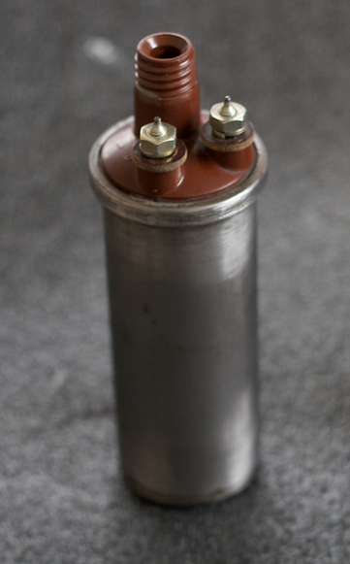
Ignition Coil
The ignition coil is essentially a high-voltage step-up transformer made up of two coils of wire. One coil of wire is called the primary coil. Wrapped around it is the secondary coil. The secondary coil normally has hundreds of times more turns of wire than the primary coil. Current flows from the battery through the primary winding of the coil.
The key to the coil's operation is what happens when the circuit is suddenly opened by the points. The magnetic field surrounding the secondary coil changes rapidly, inducing very high voltage in the secondary coil, (greater than 20,000 volts) because of the number of coils in the secondary winding.
Ignition Coil Video. (4:06)
By Honda CB77 Restoration [CC BY 2.0 (http://creativecommons.org/licenses/by/2.0)], via Wikimedia Commons
Notes:
By Honda CB77 Restoration [CC BY 2.0 (http://creativecommons.org/licenses/by/2.0)], via Wikimedia Commons

Slide 26
The End

Slide 27
Extra

Slide 28
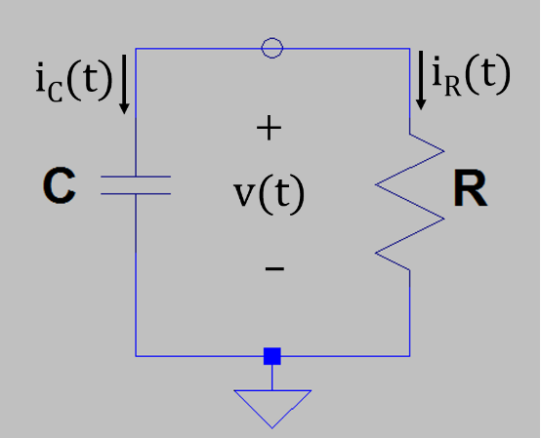
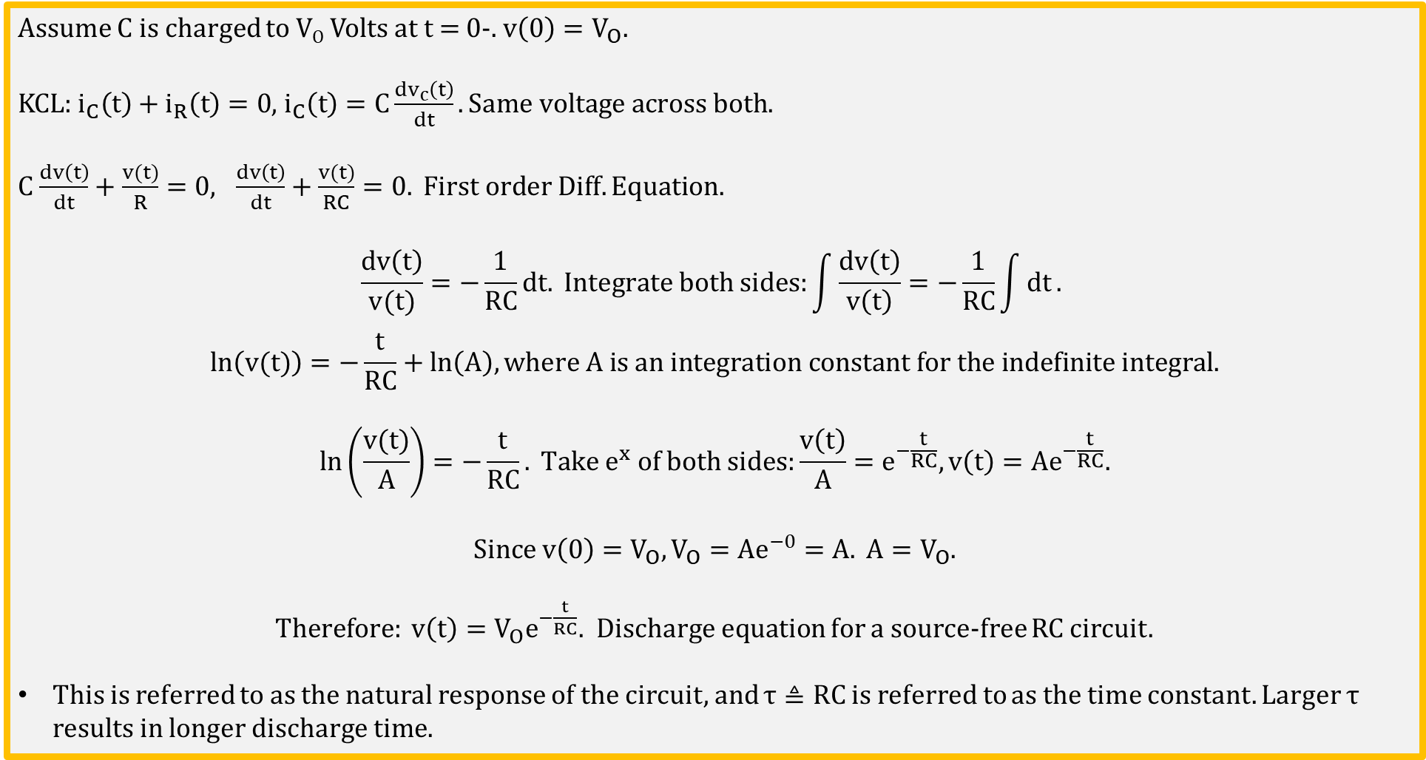
Source-Free RC Circuit
Assume C is charged to V_{O} Volts at t = 0-. $v\left(0\right)=V_{O}.$
KCL: $i_{C}\left(t\right)+i_{R}\left(t\right)=0$, $i_{C}\left(t\right)=C\frac{{dv}_{c}\left(t\right)}{dt}.Same voltage across both.$
$C$ $\frac{dv\left(t\right)}{dt}+\frac{v(t)}{R}=0, \frac{dv\left(t\right)}{dt}+\frac{v(t)}{RC}=0. First order Diff. Equation.$
$$\frac{dv\left(t\right)}{v(t)}=−\frac{1}{RC}dt. Integrate both sides:\int{\frac{dv\left(t\right)}{v\left(t\right)}}=−\frac{1}{RC}\int{dt}.$$
$$ln\left(v(t)\right)=−\frac{t}{RC}+ln\left(A\right), where A is an integration constant for the indefinite integral.$$
$$ln\left(\frac{v(t)}{A}\right)=−\frac{t}{RC}. Take e^{x} of both sides:\frac{v\left(t\right)}{A}=e^{−\frac{t}{RC}},v\left(t\right)={Ae}^{−\frac{t}{RC}}.$$
$$Since v\left(0\right)=V_{O},V_{O}={Ae}^{−0}=A. A=V_{O}.$$
$Therefore: v\left(t\right)={V_{O}e}^{−\frac{t}{RC}}.$ Discharge equation for a source-free RC circuit.
This is referred to as the natural response of the circuit, and $τ≜RC$ is referred to as the time constant. Larger $τ$ results in longer discharge time.
Notes:
Image by instructor.

Slide 29

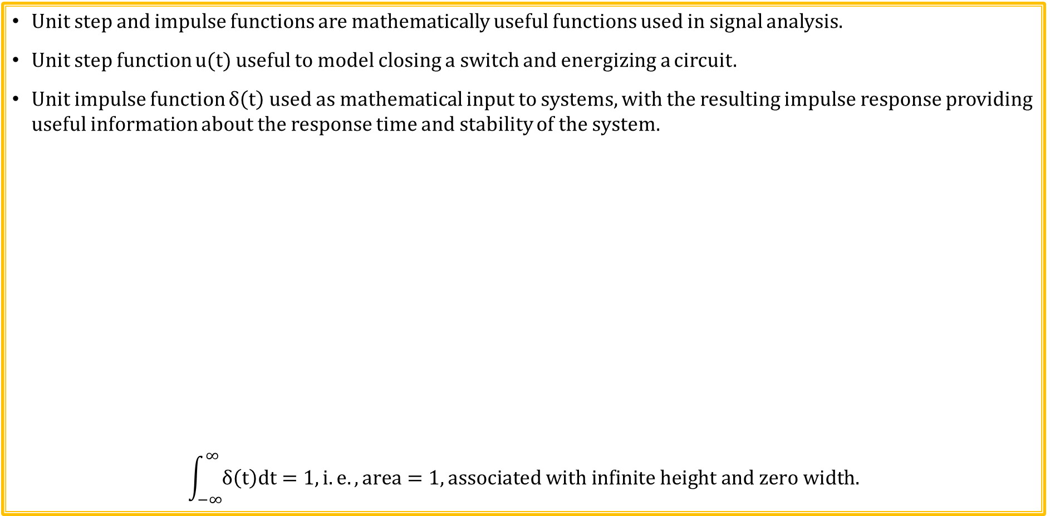

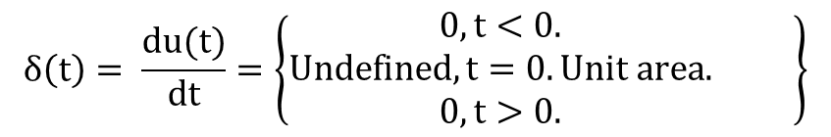

Step and Impulse Functions
Unit step and impulse functions are mathematically useful functions used in signal analysis.
Unit step function u(t) useful to model closing a switch and energizing a circuit.
Unit impulse function $δ\left(t\right)$ used as mathematical input to systems, with the resulting impulse response providing useful information about the response time and stability of the system.
$$\int_{−∞}^{∞}{δ\left(t\right)dt=1,}i.e. , area=1, associated with infinite height and zero width.$$
$$u\left(t\right)=\left\{\begin{aligned}0, t<0. \\ 1, t>0.\end{aligned} \right\}$$
u(t)
$δ$(t)
Unit Impulse: $δ$(t)
Unit Step: u(t)
1
Derivative
t
t
0
0
$$u\left(t\right)=\left\{\begin{aligned}0, t<0. \\ 1, t>0, i.e., t≥0+. \end{aligned}\right\}$$
$$δ\left(t\right)= \frac{du(t)}{dt}=\left\{\begin{aligned}0, t<0. \\ Undefined, t=0. Unit area. \\ 0, t>0.\end{aligned} \right\}$$

Slide 30
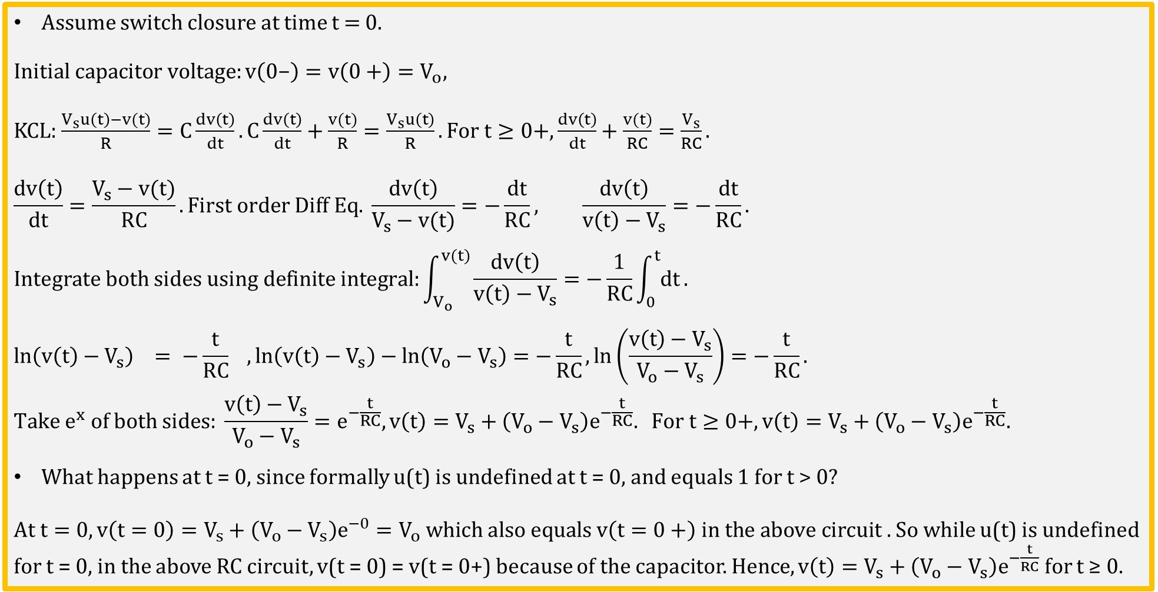
Step Response of a Series RC Circuit
Assume switch closure at time t = 0.
$$Initial capacitor voltage:v\left(0\text{−}\right)=v\left(0+\right)=V_{o},$$
KCL: $\frac{V_{s}u\left(t\right)−v(t)}{R}=C\frac{dv\left(t\right)}{dt}.C\frac{dv\left(t\right)}{dt}+\frac{v(t)}{R}=\frac{V_{s}u\left(t\right)}{R}.For t≥0+, \frac{dv\left(t\right)}{dt}+\frac{v(t)}{RC}=\frac{V_{s}}{RC}.$
$$\frac{dv\left(t\right)}{dt}=\frac{V_{s}−v(t)}{RC}.First order Diff Eq. \frac{dv\left(t\right)}{V_{s}−v(t)}=−\frac{dt}{RC}, \frac{dv\left(t\right)}{v\left(t\right)−V_{s}}=−\frac{dt}{RC}.$$
$$Integrate both sides using definite integral:\int_{V_{o}}^{v(t)}{\frac{dv\left(t\right)}{v\left(t\right)−V_{s}}}=−\frac{1}{RC}\int_{0}^{t}{dt}.$$
$$ln\left(v\left(t\right)−V_{s}\right) = −\frac{t}{RC} , ln\left(v\left(t\right)−V_{s}\right)−ln\left(V_{o}−V_{s}\right)=−\frac{t}{RC}, ln\left(\frac{v\left(t\right)−V_{s}}{V_{o}−V_{s}}\right)=−\frac{t}{RC}.$$
$$Take e^{x} of both sides: \frac{v\left(t\right)−V_{s}}{V_{o}−V_{s}}=e^{−\frac{t}{RC}},v\left(t\right)=V_{s}+\left(V_{o}−V_{s}\right)e^{−\frac{t}{RC}}. For t≥0+,v\left(t\right)=V_{s}+\left(V_{o}−V_{s}\right)e^{−\frac{t}{RC}}.$$
What happens at t = 0, since formally u(t) is undefined at t = 0, and equals 1 for t > 0?
$At t=0, v\left(t=0\right)=V_{s}+\left(V_{o}−V_{s}\right)e^{−0}=V_{o} which also equals v\left(t=0+\right) in the above circuit .$ So while u(t) is undefined for t = 0, in the above RC circuit, v(t = 0) = v(t = 0+) because of the capacitor. Hence, $v\left(t\right)=V_{s}+\left(V_{o}−V_{s}\right)e^{−\frac{t}{RC}}$ for t ≥ 0.
v(t)
t
V_{o}
0
Notes:
Image by instructor.

Slide 31




Step and Impulse Functions (Continued)
Adding the time t_{o} to the argument advances the step or impulse in time by t_{o}.
Subtracting the time t_{o} from the argument delays the step or impulse in time by t_{o}.
u(t + t_{o})
u(t - t_{o})
Unit Step: u(t + t_{o})
Unit Step: u(t - t_{o})
1
1
t
t
-t_{o}
0
0
t_{o}
$δ$(t + t_{o})
$δ$(t - t_{o})
Unit Impulse: $δ$(t + t_{o})
Unit Impulse: $δ$(t - t_{o})
t
t
-t_{o}
0
0
t_{o}

Slide 32
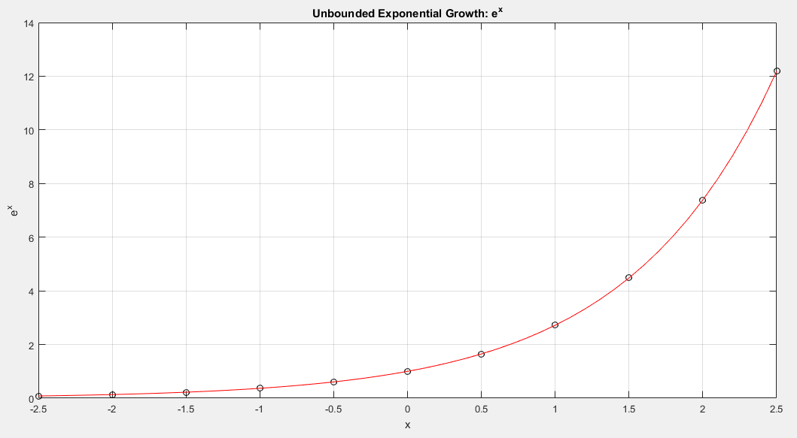
e^{x} – Important Function in STEM
(STEM – Science, Technology, Engineering & Math)
e^{x} is bounded between 0 and infinity.
-

